Slide 1
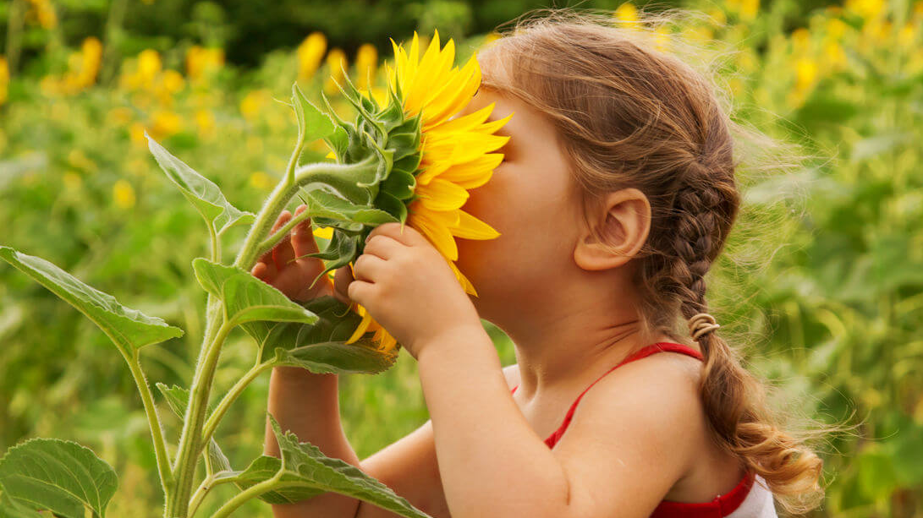
The Natural World and Children’s Development
Please be sure to view this presentation as a slide show!

Slide 2
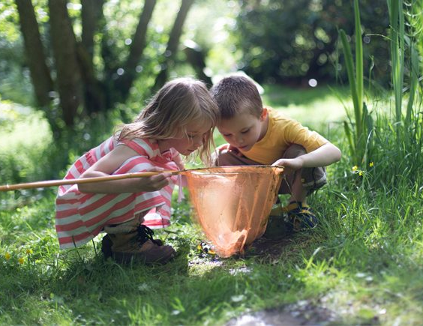
The natural world and children’s development
Welcome to this presentation on using the natural world to support children’s development.
The purpose of this presentation is to illustrate how educators can use nature as a tool to support children’s learning, the benefits of nature, and to provide resources and strategies to support children’s learning in this area.

Slide 3
At the end of this presentation, you will find a professional development survey. PLEASE take time to complete this. Your feedback is ESSENTIAL to expand needed resources on a particular topic and to create new professional development opportunities.
Reflection and feedback are important! Please be sure to complete all included forms as you navigate through this PowerPoint presentation. Thank you!

Slide 4
Why focus on nature?
Children love to learn and play in nature.
There are SO many learning opportunities for young children in the natural world.
Nature provides opportunities to expose children to learning across a multitude of domains.

Slide 5
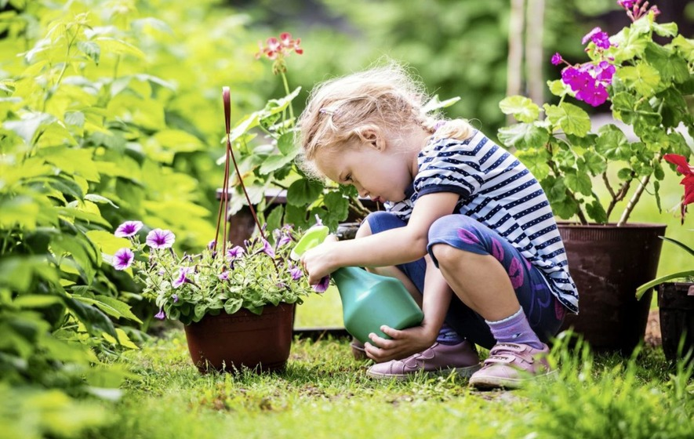
Benefits of connecting to nature
Supports multiple developmental domains: physical, emotional, social, and intellectual
Supports creativity and problem-solving
Enhances cognitive abilities
Increases physical activity
Improves self-discipline
Reduces stress
CLICK HERE for an article that focuses on all the benefits of connecting children to nature!

Slide 6
Front porch series
On the next slide, please take time to watch the video from ECLKC’s Front Porch Series: “Using the Natural World to Support Children’s Development.”
Please be sure to watch the video in its entirety to in order to receive full training hours.
Need a copy of the webinar slides? CLICK HERE
REMINDER: This is an archived webinar presentation. Polls and other chat features are now inactive.
LET’S GET STARTED!

Slide 7
USING THE NATURAL WORLD TO SUPPORT CHILDREN’S DEVELOPMENT
Please click on the title/link above to access the video.
This will take you to a separate browser to view the video.
You will need to return to the PowerPoint to finish viewing the slides and to complete the professional development survey.
“Using the Natural World to Support Children’s Development.” ECLKC, uploaded by usgovACF, 1 April 2021, https://eclkc.ohs.acf.hhs.gov/video/using-natural-world-support-childrens-development.

Slide 8
ideas you can use
Please take some time on the next several slides to explore some ideas for incorporating nature play in your program!
LET’S GO!!

Slide 9
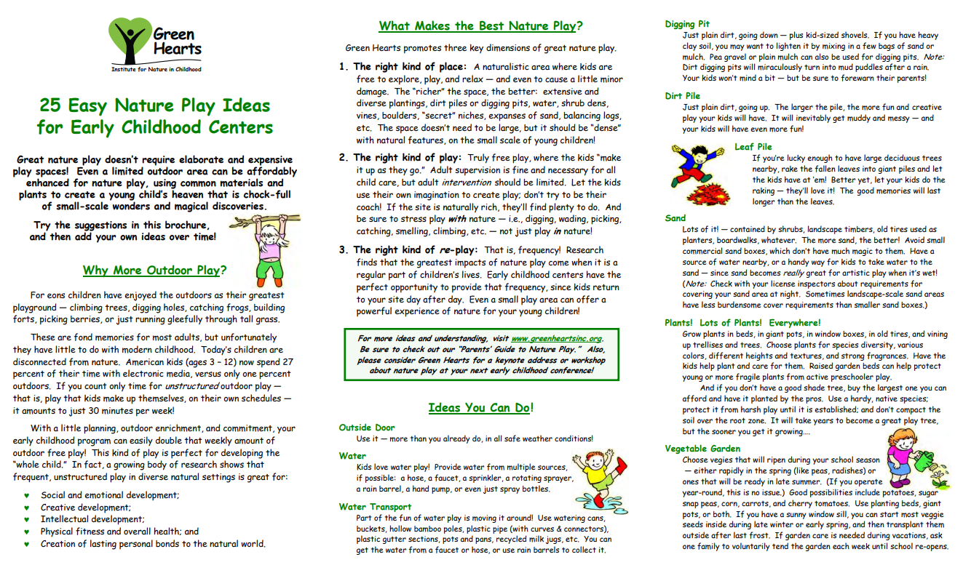

Slide 10
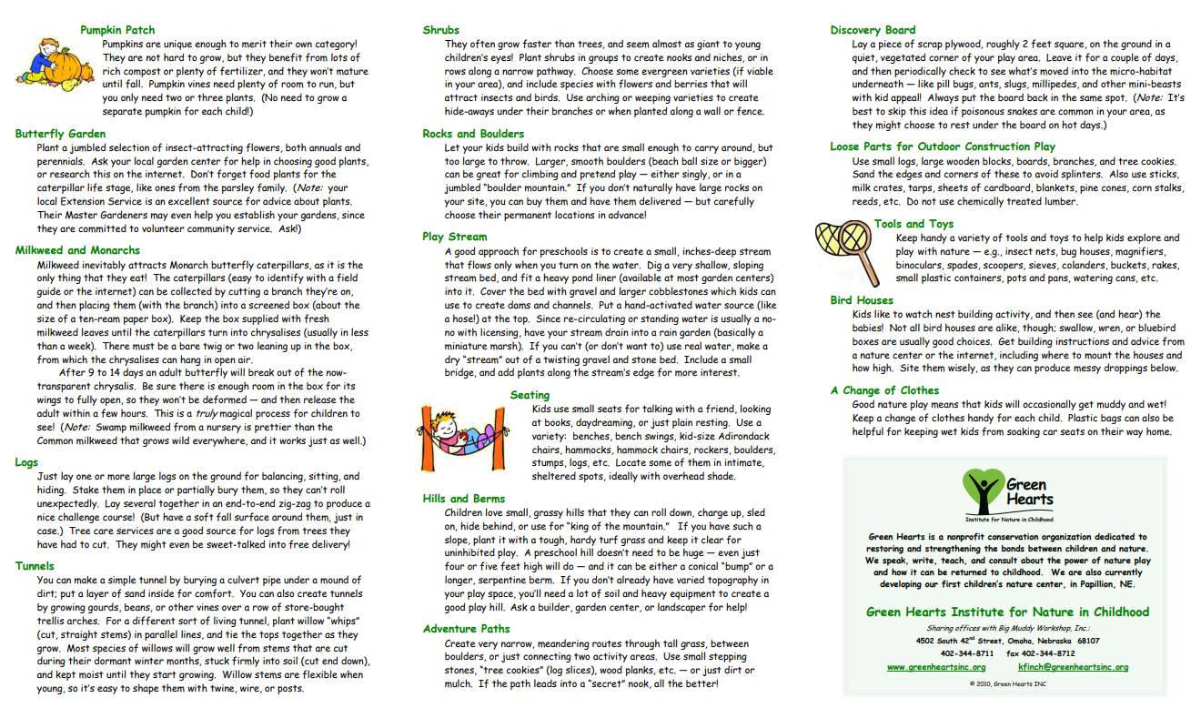
For the PDF version, please CLICK HERE

Slide 11
NEED THE PDF? Click HERE

Slide 12
Final Training Steps
Please complete the Professional Development Survey on the following slide.
Upon completion of the survey, participants will be entered onto a MiRegistry roster.
This training will appear on participants’ learning record.
Participants can access a training certificate from their profile page on MiRegistry, if desired.
This will also serve as an attendance record/sign in sheet for ChildPlus purposes.
Need the PD link instead? CLICK HERE

Slide 14
The end!!

