Slide 1
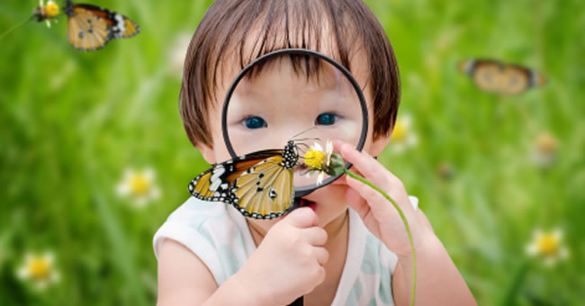
Science in Early Childhood
Please be sure to watch this presentation as a slide show!

Slide 2
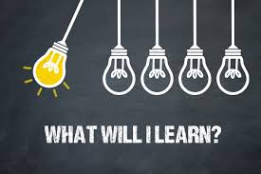
Training Objectives
Welcome to this presentation on SCIENCE!!
This PowerPoint aims to accomplish the following:
What science looks like in early childhood.
Expectations for supporting children’s development in this area.
Provide resources for implementing developmentally appropriate science activities in your learning environment.

Slide 3
At the end of this presentation, you will find a professional development survey. PLEASE take time to complete this. Your feedback is ESSENTIAL to expand needed resources on a particular topic and to create new professional development opportunities. This is also a time for you to reflect on your prior knowledge and practice. It’s an important piece of the professional development process!
Reflection and feedback are important! Please be sure to complete any included forms as you navigate through this PowerPoint presentation. Thank you!

Slide 4
How NOT to teach science!

Slide 5
What is Science?
Definition of science
1a: knowledge or a system of knowledge covering general truths or the operation of general laws especially as obtained and tested through scientific method
b: such knowledge or such a system of knowledge concerned with the physical world and its phenomena : NATURAL SCIENCE

Slide 6
Science Simplified
The definition of science can be intimidating! Do young children really learn those things? Better yet, do early childhood teachers need to teach those things?
Really, when we think about science in early childhood, we are hoping to promote the following:
Critical thinking skills
Inquiry
Raising questions
Making observations
Coming to conclusions

Slide 7
Science in Early Childhood
Take a few minutes to watch this brief video which provides an overview of science in early childhood.

Slide 8
Head Start Requirements
The Head Start Early Learning Outcomes Framework (HSELOF) lays out the skills, behaviors, and knowledge that programs must foster in ALL children.
Scientific reasoning is a piece of this!

Slide 9
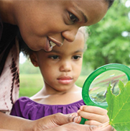
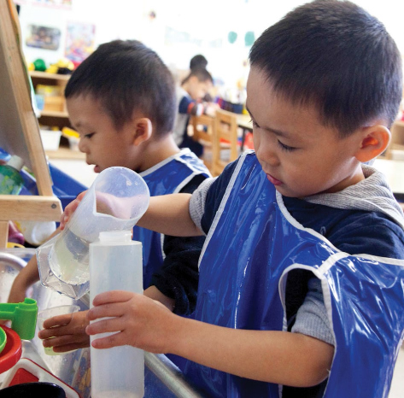
HSELOF & PRESCHOOL DEVELOPMENT
Within the scientific reasoning domain, there are two sub-domains:
Scientific inquiry
Reasoning and problem-solving
Each sub-domain has three goals.
Take some time on the next several slides to review these sub-domains and their associated goals.

Slide 10
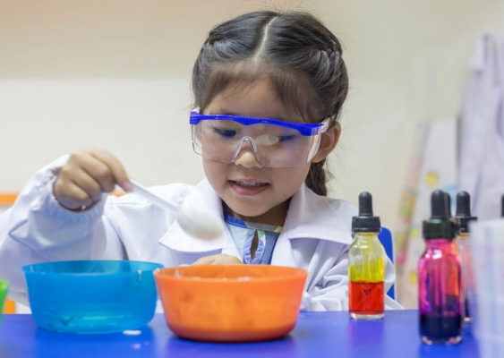
SCIENTIFIC INQUIRY
Goal P-SCI 1. Child observes and describes observable phenomena (objects, materials, organisms, and events).
Goal P-SCI 2. Child engages in scientific talk.
Goal P-SCI 3. Child compares and categorizes observable phenomena.

Slide 11
Goal P-SCI 1. Child observes and describes observable phenomena (objects, materials, organisms, and events).

Slide 12
Goal P-SCI 2. Child engages in scientific talk.

Slide 13
Goal P-SCI 3. Child compares and categorizes observable phenomena.

Slide 14
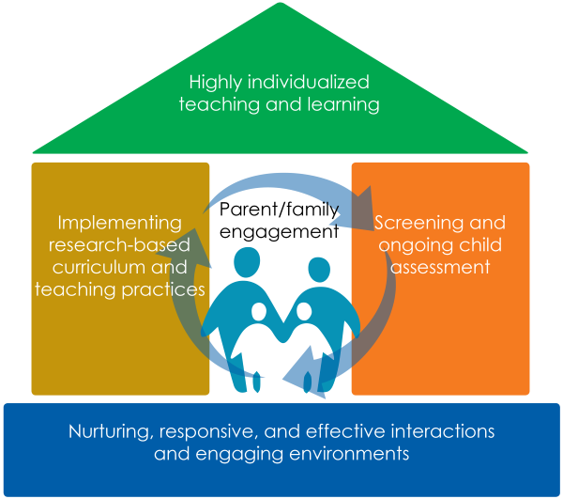
Strategies that Work
When supporting children with scientific inquiry, intentional teaching is key!
How does your environment support children to safely and openly explore?
Do the materials you provide support their natural curiosity?
Are teachers actively engaged with all children? Are they following children’s cues, leads and interests?
Let’s take a look at some resources from ECLKC on the next few slides.

Slide 15
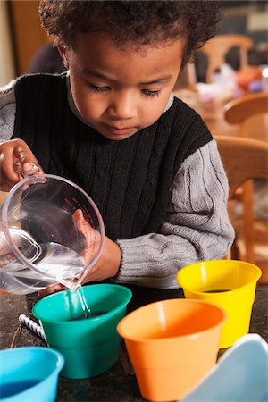
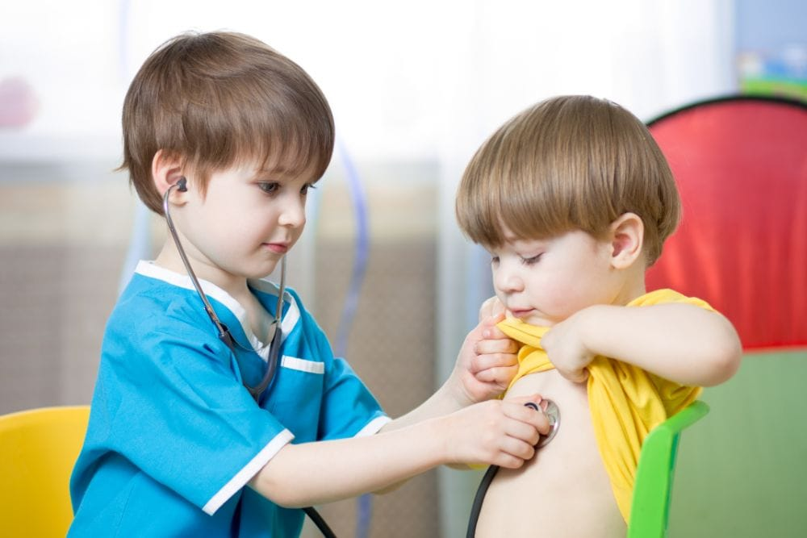
ENVIRONMENT
Provide tools to support children’s discoveries. Last week, a nurse practitioner from the reservation health clinic visited the program to explain to the children what takes place during a check-up. She demonstrated how to use a stethoscope and let the children take turns using it. The clinic just updated their equipment, so she left several older stethoscopes behind for the children’s use. Hazel puts on a stethoscope and listens to Abel’s heartbeat. “Can you hear it?” Abel asks. “I can,” says Hazel. “It goes lub dub, lub dub, lub dub.”
Provide measurement tools so children can identify similarities and differences. During a home visit, Gino, age 4, and his mother, Ms. Pizzo, bake bread with their home visitor, Ms. Dean. Gino wants to put raisins in the bread. He looks at Ms. Dean. Ms. Dean says to Gino’s mom, “What do you think?” His mother nods and asks Gino, “How many raisins do you think we need?” “This many,” says Gino, pointing to the measuring cup. “That would be a lot,” says his mother. “How about we use half as much?” pointing to the ½ cup. “Okay,” says Gino, and fills the ½ cup with raisins. Ms. Dean smiles and says, “You helped Gino see the difference between the full cup and the half cup. I can’t wait to taste this bread!”
https://eclkc.ohs.acf.hhs.gov/school-readiness/effective-practice-guides/scientific-inquiry-know

Slide 16
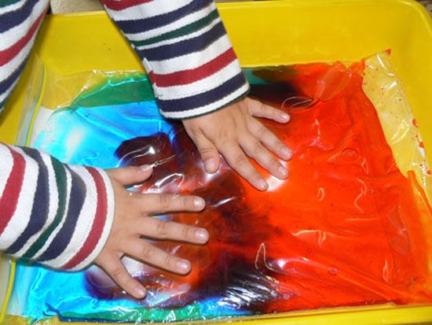
INTERACTIONS
Introduce vocabulary used to describe scientific processes and discoveries. The 4-year-olds in Ms. Warren’s class have been learning about what floats and what sinks in water. Ms. Warren says, “Please keep track of your predictions and findings. You can document the results on this chart.” Rhonda says to Haroun, “The rock is dense so it will sink to the bottom. I need to write my prediction on the chart.” Ms. Warren writes down Rhonda’s prediction and makes a note to add “dense” and “katīm” (dense in Arabic) to the science word wall.
Encourage children to use their senses to observe, compare, and categorize their discoveries. Home visitors Mr. Prince and Ms. Duchamp are meeting to plan next week’s activities for the program’s group socialization session. Last time they read a book about the five senses, so they want to plan a follow-up activity. “Several parents suggested that we have feely bags,” says Ms. Duchamp. “Children can use their senses to figure out what’s inside. Their parents can contribute items for the bags. We can co-introduce the activity with them. Then, they can help the children document their findings.”

Slide 17
INDIVIDUALIZATION
Share books, teach related vocabulary, and provide information and materials to help a child further explore an interest. Janelle, almost 5, attends a Head Start program in Anchorage, Alaska. The program has invited an artist to sew and bead a giant Yup’ik-style slipper. Janelle is fascinated by the project. It’s her nature to become highly focused on a specific interest, delving into the content for a long period of time. She asks many questions about the size of the slipper and how it compares to the size of her own slippers. Her teacher, Ms. Chambers helps Janelle measure her own slipper to compare the size to the Yup’ik-style slipper. She also helps Janelle look up Yup’ik-style footwear online so she can learn more about the materials and tools used to make them.
Follow a child’s lead and offer plenty of time for exploring and discovering. All the children are excited to see snow falling outside. They don’t often get snow in the areas where their families pick crops, so they are especially interested in this change in the weather. After a few minutes, all but one child returns to their play. Antonio, age 3, is still staring out the window. He asks, “Where did it come from? Where does it go?” Ms. Ferris, his family child care provider, says, “Let’s collect some snow in a bucket so you can get a better look at it. You can bring it inside if you'd like to see what happens when snow is indoors.” Antonio gets a bucket from the water table and Ms. Ferris places it outside the door. She then suggests they look at a book about different types of weather to learn more about snow while they wait for the bucket to fill.

Slide 18
PUTTING IT IN PRACTICE
Facilitate and scaffold children’s observation skills. Introduce the observation process using simple, familiar objects and encourage children to hold and touch the objects and use all their senses to note specific details. Invite children to describe their observations and ask questions to guide their observations (e.g., “What do you notice about…?” What does it look like, feel like, sound like, smell like?”).
Go on a nature walk or visit another part of your setting (e.g., front office in a center, kitchen in family childcare home, gym in a school-based program). Give children paper and a writing tool so they can draw what they see and hear. Encourage them to explore the environment using their senses. When you and the children get back, create a group list of sights, sounds, smells, and more.
Use science vocabulary, like observe, predict, question, investi-gate, compare, and classify, when describing objects, materials, organisms, and events in your setting. Encourage and scaffold children in using these words as they explore and discover.
Organize your environment so that cleanup time turns into a sorting experience. Provide guidance about where things should go (e.g., “The rectangle blocks go together on this shelf.” “All the crayons go together in one box, and all the markers in another box.”).
Provide a variety of objects to sort and engage children in conversations about sorting and classifying. Ask open-ended questions, help children label the groups and verbalize their criteria for sorting, and encourage them to come up with their own criteria for sorting.
Include science materials (e.g., building sets, pulleys, wheels, levers, ramps, tubes, funnels, sifters, magnets, magnifying glasses, balance scales, seeds, soil, rocks, shells) in different parts of your environment (e.g., dramatic play, blocks, manipulatives, sensory table, art, music/movement, books/writing, science/discovery, outdoors). Choose materials that are open-ended and encourage children to explore.
Include books with science-related content. For example, nonfiction informational books about things and events in the world, such as insects, animals, seeds, the seasons, fruits and vegetables, or the human body, provide resources for children’s investigations through pictures and descriptions, and enrich children’s knowledge about their world. Numerous story books, such as The Tiny Seed by Eric Carle or The Happy Day by Ruth Krauss, have science connections and can be starting points for discussing concepts such as growth or seasonal and weather changes.
https://eclkc.ohs.acf.hhs.gov/school-readiness/effective-practice-guides/scientific-inquiry-do

Slide 19
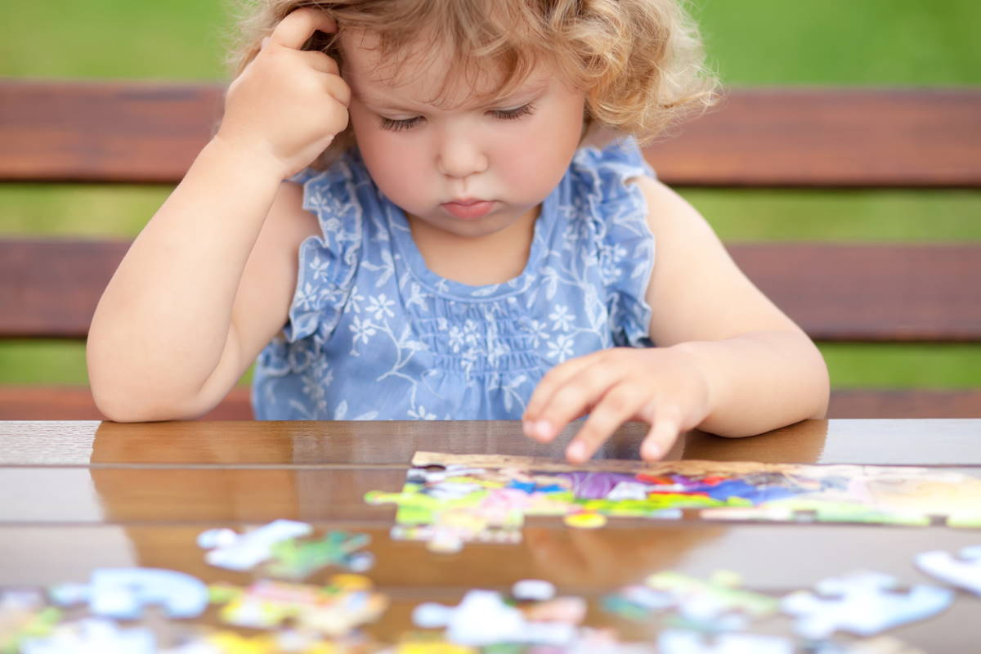
REASONING & PROBLEM-SOLVING
Goal P-SCI 4. Child asks a question, gathers information, and makes predictions.
Goal P-SCI 5. Child plans and conducts investigations and experiments.
Goal P-SCI 6. Child analyzes results, draws conclusions, and communicates results.

Slide 20
Goal P-SCI 4. Child asks a question, gathers information, and makes predictions.

Slide 21
Goal P-SCI 5. Child plans and conducts investigations and experiments.

Slide 22
Goal P-SCI 6. Child analyzes results, draws conclusions, and communicates results.

Slide 23
Strategies that Work
Just like with scientific inquiry, intentional teaching practices are key to supporting children with their reasoning and problem-solving skills.
Let’s explore some ideas and resources from ECLKC on the next few slides.

Slide 24
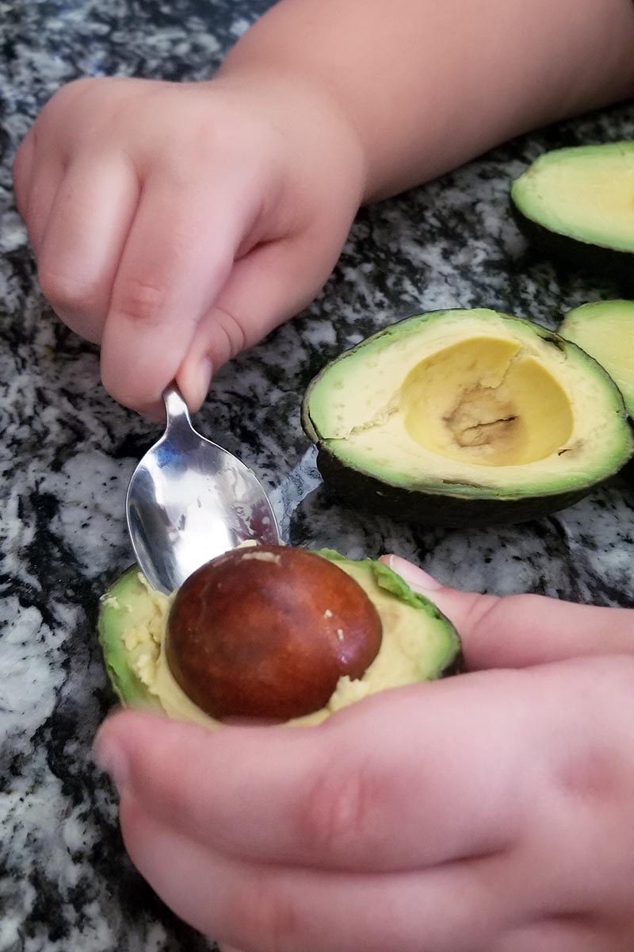
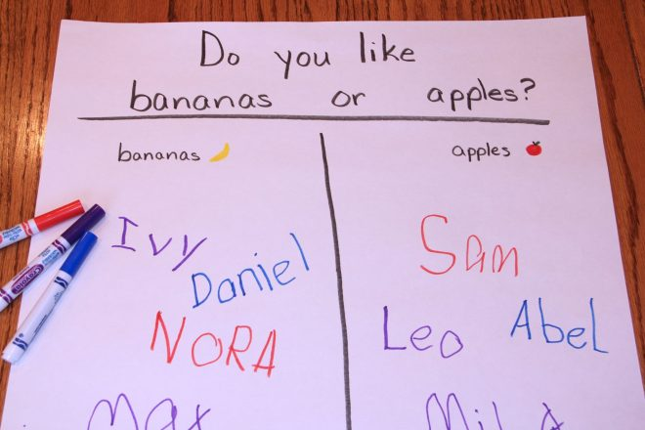
ENVIRONMENT
Provide the materials needed to conduct investigations and experiments. Teresa, age 4½, looks at an avocado pit rooting in water and asks, “Why do avocado pits have to go in water? Why can’t we just plant them in dirt?” Ms. Grant, her teacher, responds, “That is an interesting question. I wonder what would happen if you planted an avocado pit right in the dirt. Next time we eat an avocado, we can save the pit. You can plant it in our class garden and watch what happens.”
Provide the materials needed to document and communicate results to others. At a morning meeting, Ms. Ferraro demonstrates how to use a to document findings. “I wanted to know what fruit the children prefer. This is called a T-chart because the lines on it look like a T. Here is a picture of a kiwi and here is a picture of a mango. After you taste each fruit, write your name under the fruit you like the best. Later, we can count the names to see which fruit is the class favorite. You might want to make your own T-charts. You’ll find paper and pencils in the science area.”
https://eclkc.ohs.acf.hhs.gov/school-readiness/effective-practice-guides/reasoning-problem-solving-know

Slide 25
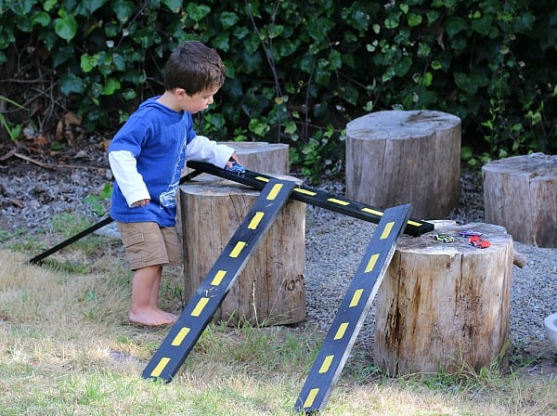
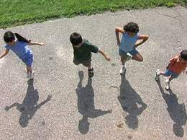
INTERACTIONS
Teach children how to use the scientific method to answer their own questions. The 4- and 5-year-olds have been creating ramps and pathways for the toy cars all week. Karla says, “Javier’s car always goes fastest. How can I make my car go as fast as his?” Ms. Thomas says, “You can use the scientific method to answer your question. You already observed how fast Javier’s car goes down the ramp and compared it to the speed of your car. Next, you asked a question, and now it is time for the hypothesis. Why do you think Javier’s car goes faster than yours? When you have your hypothesis, then you can plan and conduct an experiment to see if your hypothesis is correct.”
Comment and ask questions that encourage children’s thinking and learning. Outside on the playground, several 3-year-olds have become fascinated by their shadows. On cloudy days, they wonder where their shadows have gone and on sunny days are thrilled to see they are back. Mr. Kent says, “Try jumping up and down. What happens to your shadow?” The children try this and Norah says, “My shadow jumped, too.” Next, Mr. Kent suggests they wiggle their bodies to see what happens to their shadows.” Later, he says to his colleague, Ms. Anderson, “The children are very interested in their shadows. I think we should plan a study so they can learn more.”

Slide 26
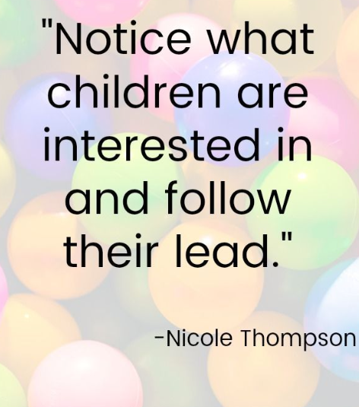
INDIVIDUALIZATION
Accept a child’s thinking whether it is accurate or not while also scaffolding the child to a deeper or more accurate understanding. While walking to the park after a rainy day, family child care provider, Ms. Baker, and the children see some big puddles on the grass. She asks, “Where do you think those puddles came from?” “I know,” answers 4½-year-old Vivienne. “They came from under the ground. The water just bubbles up.” “That’s an interesting idea, Vivienne,” responds Ms. Baker. “I can see why you would think that because some bodies of water, like ponds or lakes, are fed from water sources under the ground. Sometimes smaller pools of water, like these puddles, are formed for only a short amount of time, and are the result of so much rain coming from the sky that the ground can’t hold it all. Kind of like when you used a sponge yesterday to clean up the spilled water pitcher. Remember that your sponge would not hold all of that water? Once it was saturated, or filled up with water, it left a pool of water behind. The earth’s soil is the same way—it can’t always hold all of the water that a rainstorm produces.
Observe and build on a child’s reasoning and problem-solving skills. During a group socialization session, preschooler Zane is playing at the water table with funnels, small pitchers, and a water wheel. He says to his mother, Ms. Shea, “If I pour the water right into the water wheel it turns really fast. If I pour it through the funnel, it doesn’t go as fast.” Ms. Warren, a home visitor, overhears Zane’s observation. She says to Ms. Shea, “Zane is a good observer. He’s learning a lot through water play. Your interest in his ideas is so important for building on what he knows.” His mother says, “I’m going to join him. Maybe we can figure out how fast and how slow he can make the water wheel turn.”

Slide 27
PUTTING IT IN PRACTICE
Chart children’s descriptions of the process they followed (e.g., the question they investigated—do plants grow higher in the dark or in sunlight?; their predictions; how they planted and watered seeds; how they measured the plants) as well as the results (e.g., how tall the plants were each day, which plants were tallest at the end). Demonstrate different ways to chart results and encourage children to record their own results.
Plan indoor and outdoor activities that help children use the scientific method to observe, make predictions, and test those predictions, such as growing plants. Scaffold children’s abilities to make predictions. For example, explain what a prediction is (a guess about what is going to happen). Encourage children to first predict and then check to see if what they predicted happened. Prompt predictions by asking questions and letting children know predictions do not have to be right. Encourage children to make multiple or alternate predictions or compare children’s predictions. Record children’s predictions.
Allow children to solve everyday problems. Ask open-ended questions that will prompt them to try different strategies (e.g., what to do at snack time when there are not enough cups at one table and not enough snacks at another table, how to carry a heavy object together, or what happens when you mix two colors).
Help children analyze their results and draw conclusions. Ask questions to help children think about what happened and why they think it happened.
For example, if children predicted that plants would grow higher in the dark than in sunlight, encourage them to look at the results (plants grew higher in sunlight) and offer ideas for what made the difference, given that all the plants received the same amount of watering.
Promote the use of scientific tools, such as magnifiers and measuring instruments, to extend children’s investigations. Make sure tools are available and in good working order, and that children know what they are used for and how to use them.
https://eclkc.ohs.acf.hhs.gov/school-readiness/effective-practice-guides/reasoning-problem-solving-do

Slide 28
Fostering Children’s Thinking Skills
Educators play an important role in helping children to develop critical thinking skills.
Please watch this brief video on how to support children in this area of development.

Slide 29
Fostering Children’s Thinking Skills
What does it look like?
Classroom interactions that focus on “big ideas” and deepen children’s knowledge of the world around them.
Children’s thinking skills can be fostered during interactions that involve:
Using the scientific method
Problem-solving
Applying knowledge
What does it NOT look like?
Drilling children on facts or skills.

Slide 30
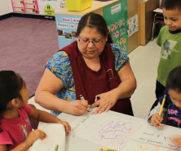
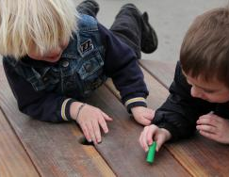
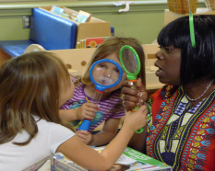
When Can I FOSTER CHILDREN’S THINKING SKILLS?
It’s happening all the time!
Teachers can foster children’s thinking and understanding throughout the school day in many classroom activities.
Can you think of different times throughout your daily routine that you are actively fostering children’s thinking skills?

Slide 31
Fostering children’s thinking skills is an important process in all areas of children’s learning, but especially with scientific concepts.
Need some additional tips and strategies for fostering children’s thinking skills?
Check out the next slide for some valuable resources!

Slide 32
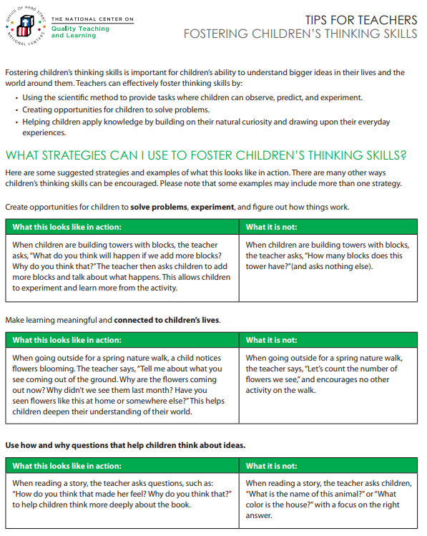
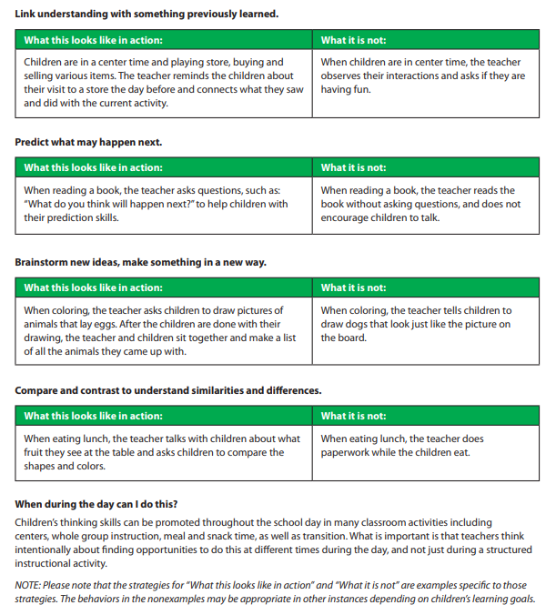
CLICK HERE for a PDF version!

Slide 33
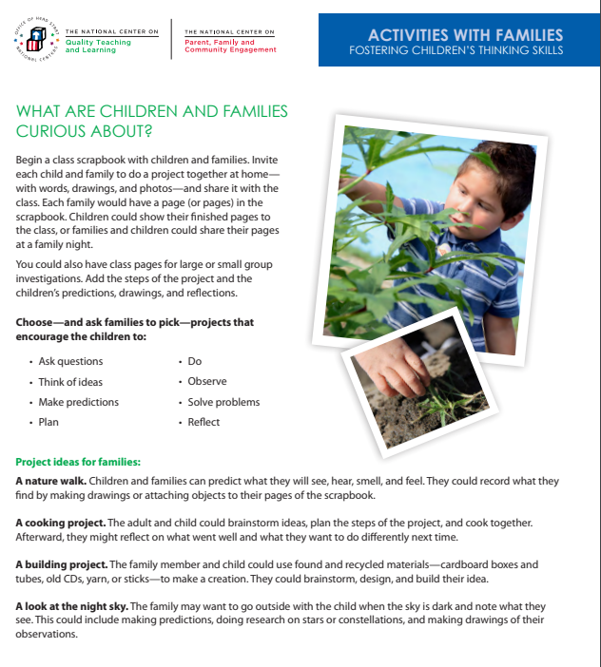
Involving Families
Help families support their children at home with this important skill.
Check out this easy way to get your families involved.
Need a tip sheet to share with families? CLICK HERE
Need to print out this activity sheet? CLICK HERE

Slide 34
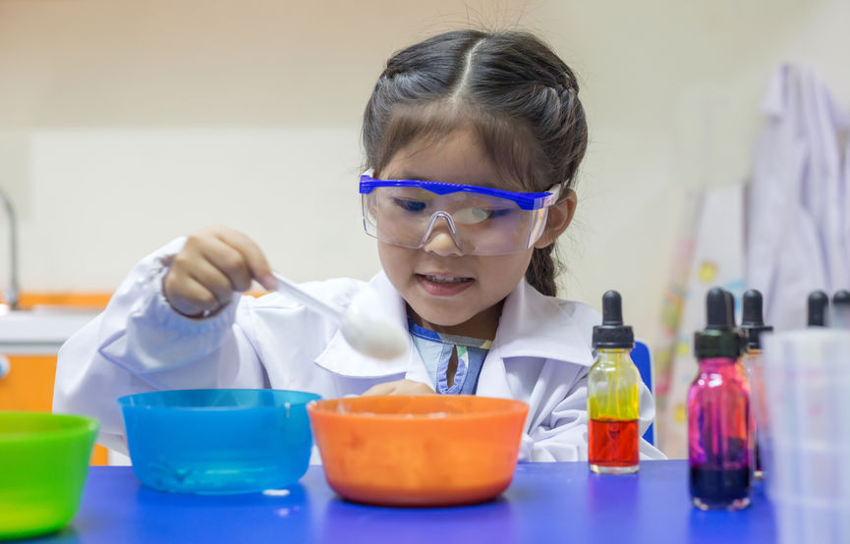
SCIENTIFIC METHOD
What is it?
How is it relevant in early childhood?
Let’s find out!

Slide 35
Scientific Method
Please watch this brief video that provides an overview of scientific method in early childhood learning environments.

Slide 36
Scientific Method
The scientific method is a process that scientists use to study the world around them.
Young children are natural scientists who are constantly exploring the world around them.
It’s never too early to introduce children to scientific concepts and vocabulary.

Slide 37
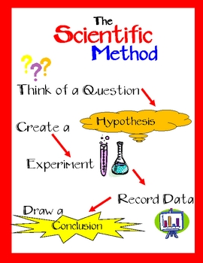
Scientific Method: The Steps
The scientific method is made up of several steps:
Make observations
Form questions
Develop a hypothesis
Test the hypothesis
Record the results
Share the results
Children naturally use these steps as they explore their world.
Are you thinking, “How can I use these steps with children?”
Let’s find out!

Slide 38
Make Observations
Ask open-ended questions that encourage children to make observations:
What do you hear, taste, smell, see, feel?
What did you notice?
Can you tell me about what you made?

Slide 39
Form Questions
Encourage children to form questions about their observations. This is the wonder step!
I wonder why the tower collapsed?
I wonder what will happen if that gets wet?
I wonder why the leaves are wilted?
I wonder what might happen if we mix these colors?

Slide 40
Develop a Hypothesis
The “I think” step is next. Encourage children to make a prediction about their questions.
I think the tower collapsed because it was too tall.
I think if that gets wet it will be slippery.
I think the leaves are wilted because they are thirsty.
I think if we mix the colors it will be messy.

Slide 41
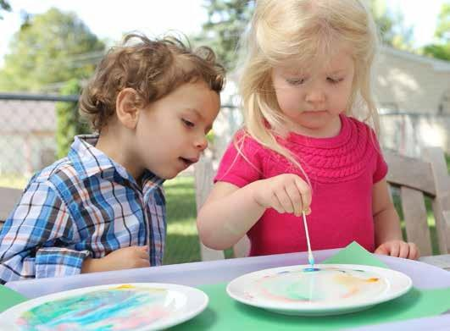
Test the Hypothesis
Now the fun begins: Let the children try out their hypothesis. Did what they think would happen really happen?
Maybe they make a smaller tower so it doesn’t collapse.
Maybe they spray items to see if they become slippery.
Maybe they water the leaves to see if that reverses the wilting.
Maybe they mix the colors to see if it causes a mess.

Slide 42
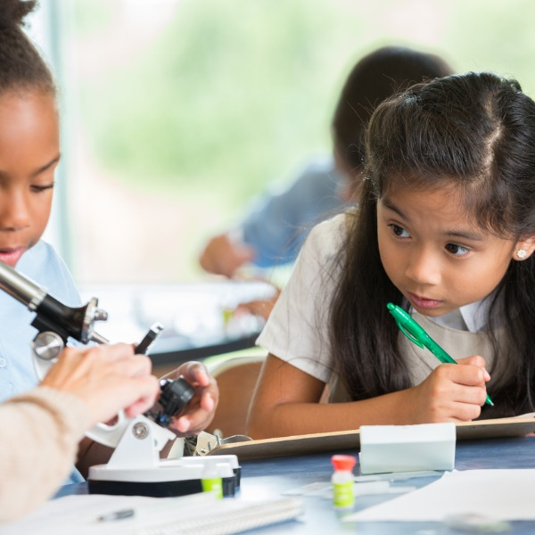
Record the Results
Children can record their results just like real scientists do.
They can talk about the results.
Encourage children to draw pictures or “write” about their findings; be sure to provide plenty of paper or blank books throughout the learning environment.
Have adults take videos of the children’s findings.
Take pictures of the children with experiment results.

Slide 43
Share the Results
We’ve reached the final step! Here are some ways that children can share their scientific results:
Have a back-and-forth conversation about their scientific process.
Have children invite other children to participate in another experiment to see the results.
Encourage children to share their results at group time or with their parents at pickup time.
Be sure to hang their drawings, writings, and pictures throughout the room for all to see!

Slide 44
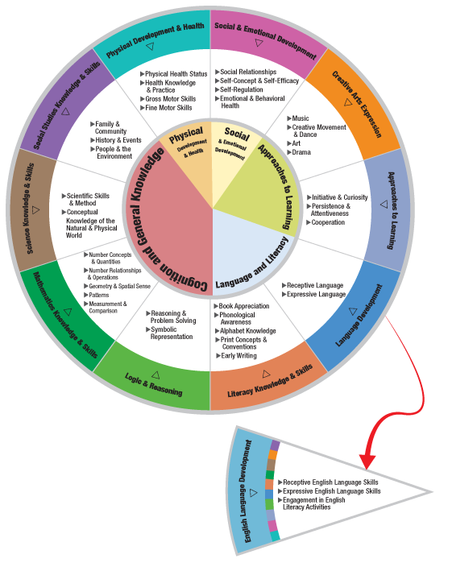
THE HEAD START CHILD DEVELOPMENT AND EARLY LEARNING FRAMEWORK
The scientific method can be incorporated within many areas of the framework.
Some examples are:
Logic & Reasoning
Literacy Knowledge & Skills
Mathematical Knowledge & Skills
Social & Emotional Development
Science Knowledge & Skills

Slide 45
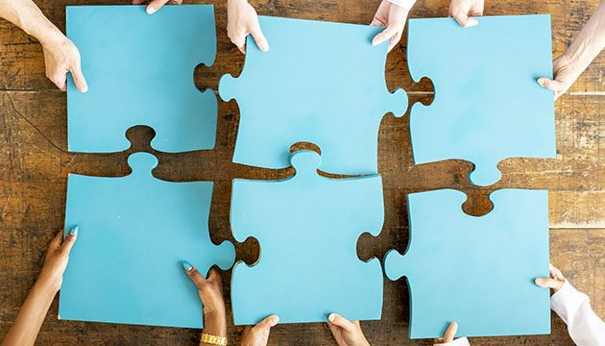
Putting it ALL Together!
Fostering children’s thinking skills goes hand-in-hand with intentionally incorporating scientific methods in the learning environment.
REMEMBER….science isn’t just about planned experiments or activities at small group.
Science is happening ALL around us ALL the time.
Take advantage of those “teachable” moments throughout the day to engage children in scientific thinking.
The next few slides summarize how to support children’s thinking skills while building their knowledge around science.

Slide 46
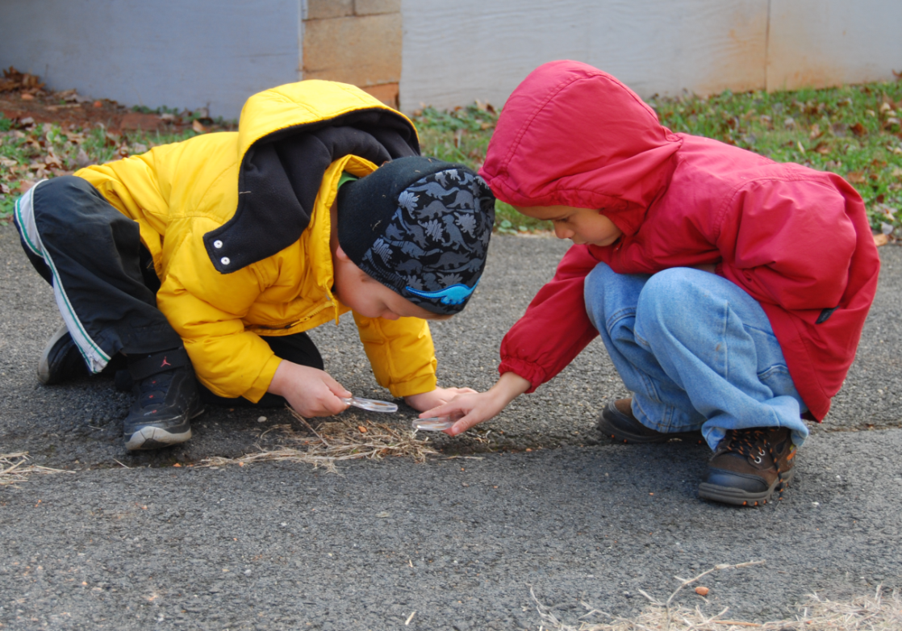
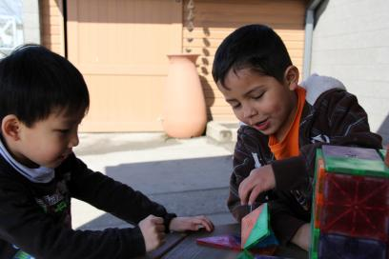
Fostering children’s thinking skills by USING THE SCIENTIFIC METHOD
Provide tasks where children can observe, predict, and experiment.

Slide 47
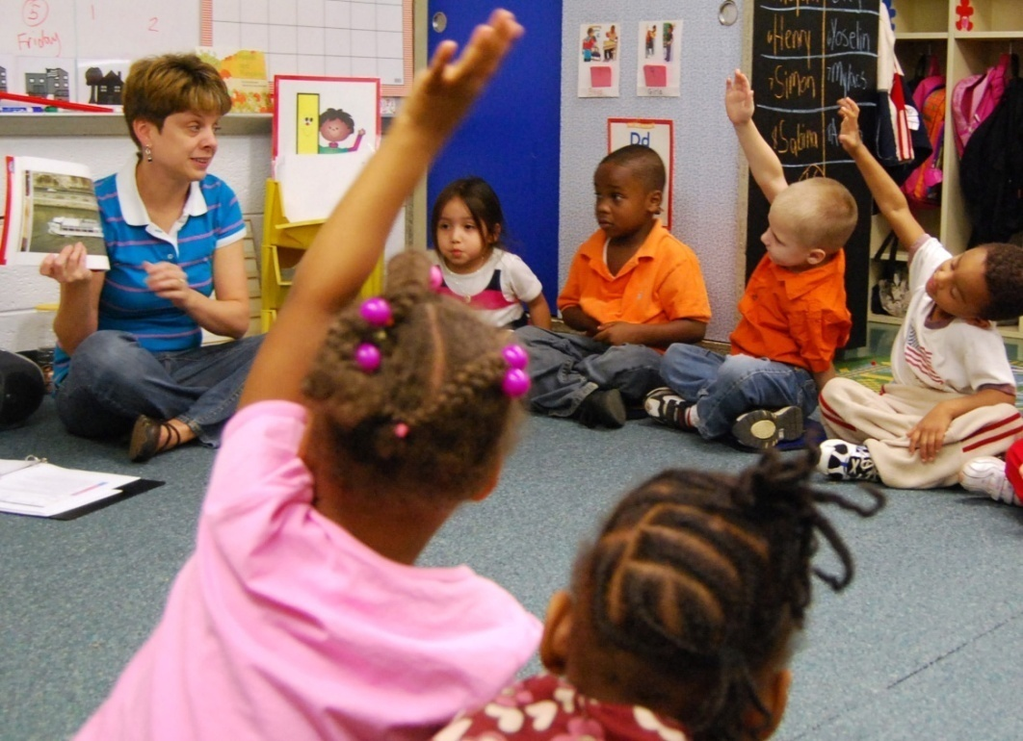
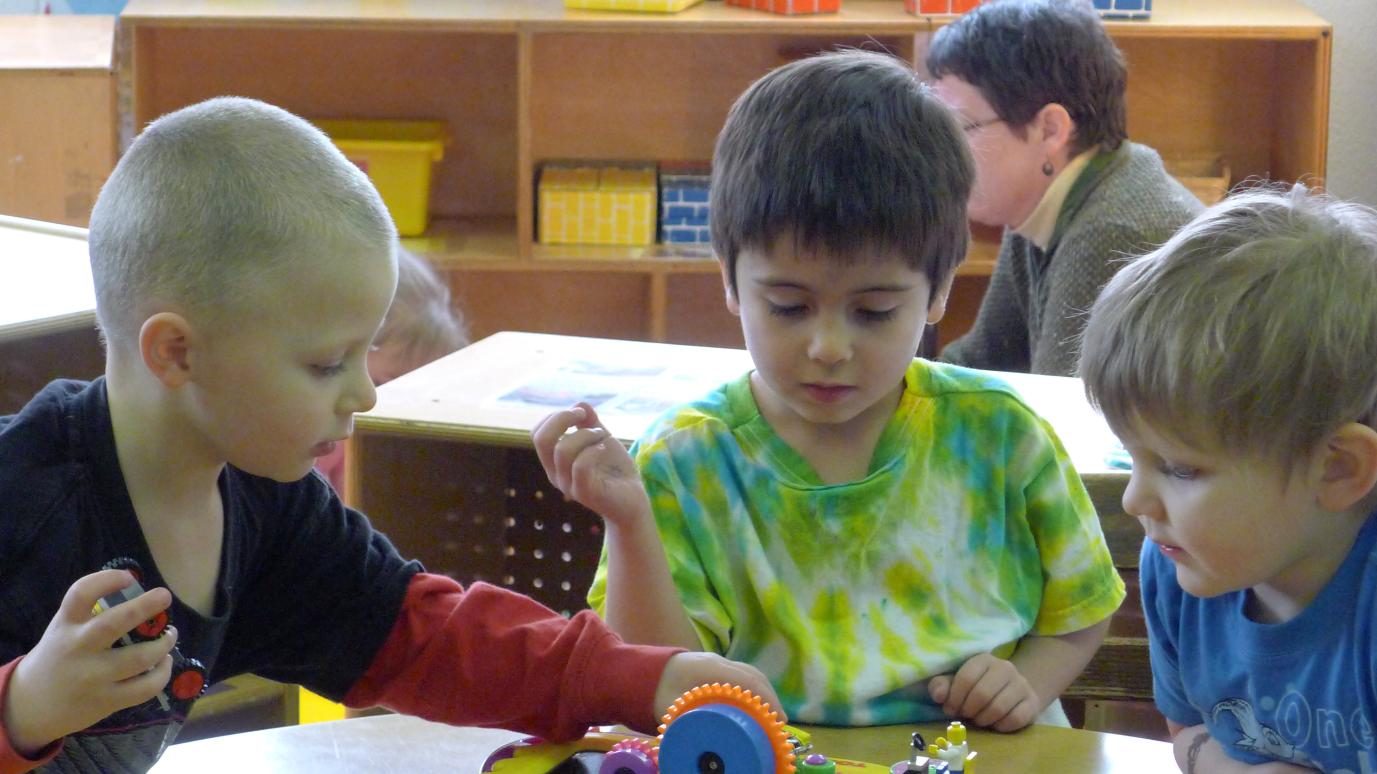
Fostering children’s thinking skills by PROBLEM-SOLVING
Create opportunities for children to brainstorm, plan, and solve problems.

Slide 48
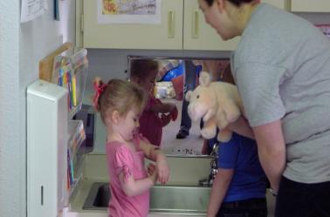
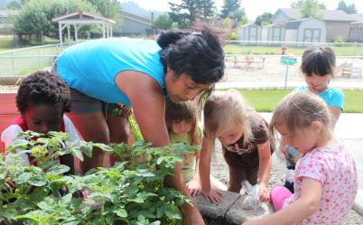
Fostering children’s thinking skills by APPLYING KNOWLEDGE
Build on children’s natural curiosity by drawing upon their everyday experiences and connecting previous knowledge.

Slide 49
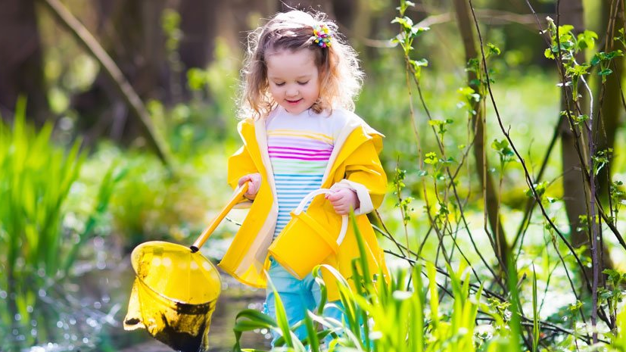
Science in Nature
Take a few minutes to watch the following video. See how easy it is to experience science in everyday activities.
Click on the link to access the video. It will take you to an outside browser. Just return to the PowerPoint when you’re done!
How to Play in Nature: Science Ideas for Teachers

Slide 50
FINAL TRAINING STEPS
Complete the Professional Development Survey on the following slide.
Upon completion of the survey, participants will be entered into a roster on MiRegistry.
This training will appear on participants’ learning record.
Staff can access a training certificate from their profile page on MiRegistry, if desired.
This will also serve as an attendance record/sign-in sheet for ChildPlus purposes.
Need a link to the PD survey instead? CLICK HERE

Slide 52
REFERENCES
“Fostering Children’s Thinking Skills.” YouTube, uploaded by usgovACF, 15 July 2015, https://www.youtube.com/watch?v=fYMdWQVg26Y.
“Science.” Merriam-Webster.com Dictionary, Merriam-Webster, https://www.merriam-webster.com/dictionary/science. Accessed 1 Apr. 2022.
“Science in Early Childhood.” YouTube, uploaded by Maria George, 22 March 2020, https://www.youtube.com/watch?v=qDkFim5yhFY.
“Teaching Some Science-The Big Bang Theory.” YouTube, uploaded by YoureInMySpotFBPAGE, 3 Aug. 2013, https://www.youtube.com/watch?v=PzwTxVncWrI.
“Using the Scientific Method.” YouTube, uploaded by usgovACF, 15 July 2015, https://www.youtube.com/watch?v=bFr5IP5po2A.

Slide 53
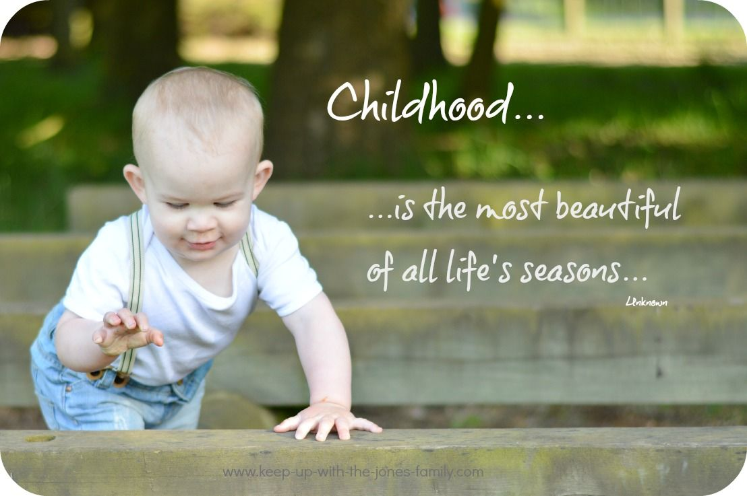
THE END!

