Slide 1
Asking Questions: Inspire Higher-Level Thinking and Foster Cultural Responsiveness
Please be sure to watch this as a slide show!

Slide 2
The Art of Asking Questions
Welcome to this presentation on asking children questions to support higher-level thinking and to foster cultural responsiveness.
The purpose of this training is to examine how educators can support children in their higher-level thinking development.
Additionally, ways to support children’s thoughts about diversity will also be explored.
REMINDER: This is an archived webinar presentation. Polls and other chat features are now inactive.

Slide 3
At the end of this presentation, you will find a professional development survey. PLEASE take time to complete this. Your feedback is ESSENTIAL to expand needed resources on a particular topic and to create new professional development opportunities. This is also a time for you to reflect on your prior knowledge and practice. It’s an important piece of the professional development process!
Reflection and feedback are important! Please be sure to complete any included forms as you navigate through this PowerPoint presentation. Thank you!

Slide 4
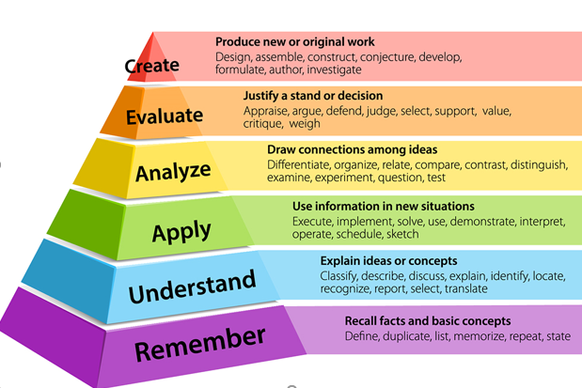
Bloom’s Taxonomy
The following presentation includes an archived webinar from NAEYC.
The content of the webinar builds on a Bloom’s Taxonomy premise.
Before watching the webinar presentation, please take time to learn more about Bloom’s Taxonomy and its importance: click here

Slide 5
NAYEC Webinar Series
On the next slide, please take time to watch the video from NAYEC: “Inspiring Higher-Level Thinking in Young Children.”
At the end of the video, you will have time to reflect on what you’ve learned and what ideas you may use moving forward.
Please be sure to watch the video in its entirety in order to receive full training hours.
Let’s get started!

Slide 6
“Inspiring Higher-Level Thinking in Young Children.”
“Inspiring Higher-Level Thinking in Young Children.” YouTube, uploaded by NAEYC, 30 Jan. 2018, https://www.youtube.com/watch?v=jdk1VR-kqMEz.

Slide 7
Final Training Steps
Complete the Professional Development Survey on the following slide.
Upon completion of the survey, all staff who participated will be entered into a roster on MiRegistry.
This training will appear on participants’ learning record.
Staff can access a training certificate from their profile page on MiRegistry, if desired.
This will also serve as an attendance record/sign-in for ChildPlus purposes!
Need a link to the PD survey instead? CLICK HERE

Slide 9
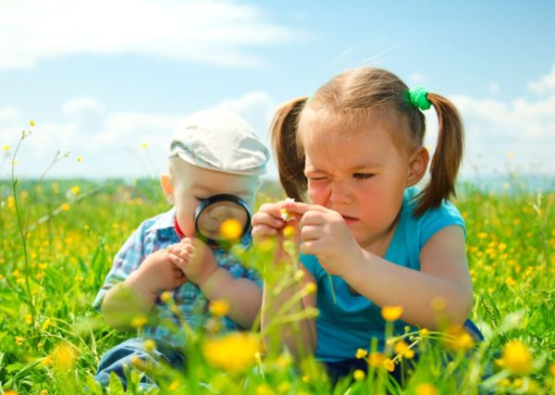
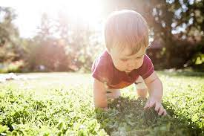
“Our greatest natural resource is the minds of our children.” Walt Disney THE END!

