Slide 1
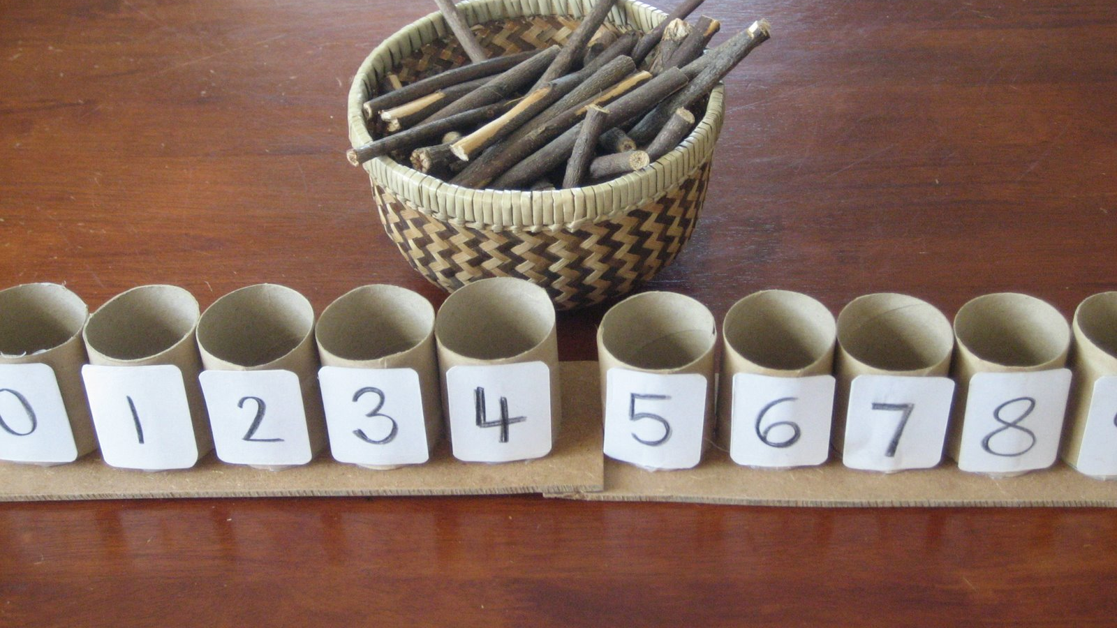
Math Progression in Pre-K
Supporting children along the math continuum

Slide 2
Math Progression in Pre-K
Welcome to this PowerPoint presentation on math progression in preschool. The purpose is to introduce concepts vital to young children’s mathematical development.
Now, let’s get started!!!

Slide 3
At the end of this presentation, you will find a professional development survey. PLEASE take time to complete this. Your feedback is ESSENTIAL to expand needed resources on a particular topic and to create new professional development opportunities. This is also a time for you to reflect on your prior knowledge and practice. It’s an important piece of the professional development process!
Reflection and feedback are important! Please be sure to complete any included forms as you navigate through this PowerPoint presentation. Thank you!

Slide 4
Teaching math got me like…….

Slide 5
The Progression of Math
Children learn math along a continuum just like they do other areas of development.
Watch the following video, “The Progression of Early Numbers and Counting,” to learn more about math development in young children.

Slide 7
Digging Deeper
Let’s take some time to dig a little deeper into the following math concepts:
Subitizing
More or less
One-to-one correspondence
Cardinality

Slide 8
Subitizing
Subitizing is the ability to quickly and accurately recognize a small group of objects without counting.
Look at each card and count the dots. Did you have to count the different dots to know how many were on each card? Likely not. You used your subitizing skills!

Slide 9
Watch the video below for more subitizing knowledge and ideas!
Think about your learning environment and daily routine. How can you support children with their subitizing skills?

Slide 11
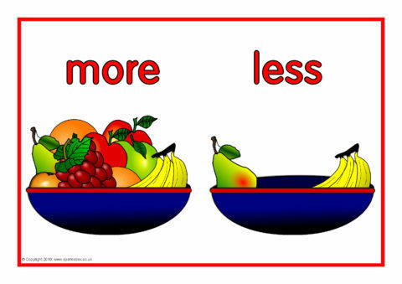
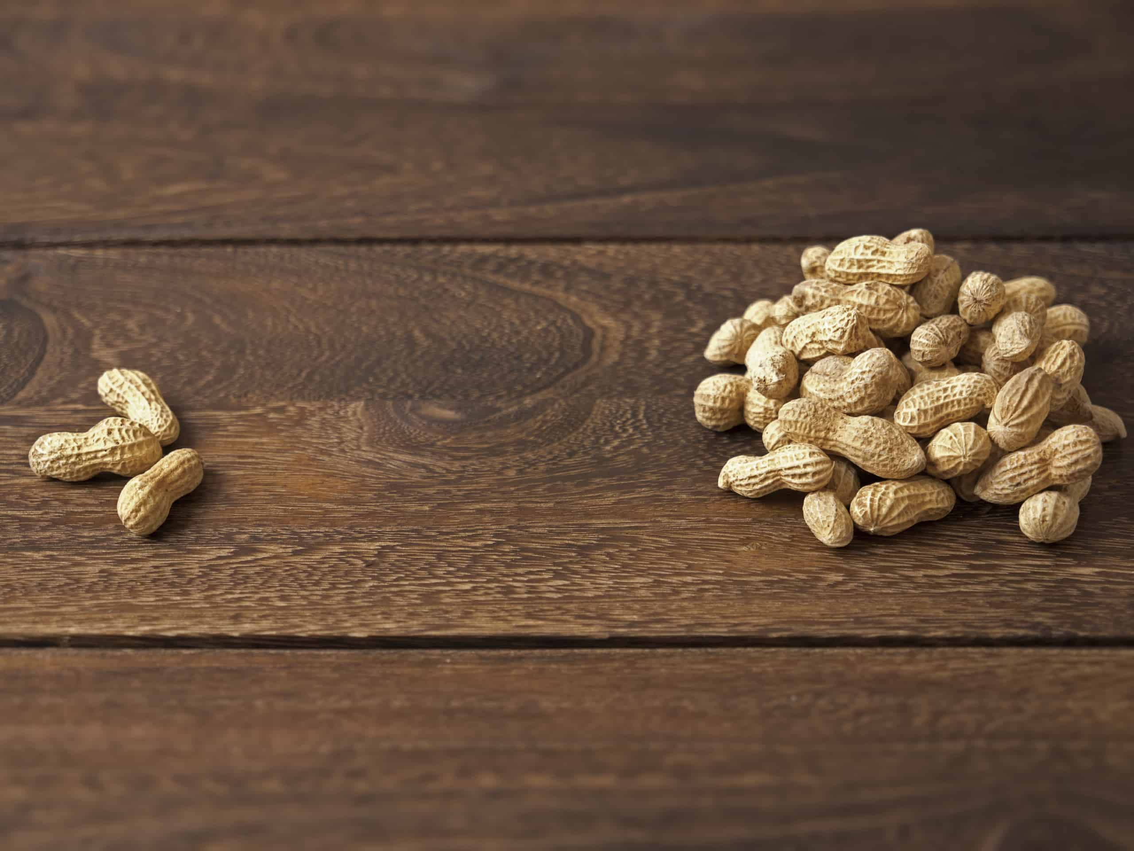
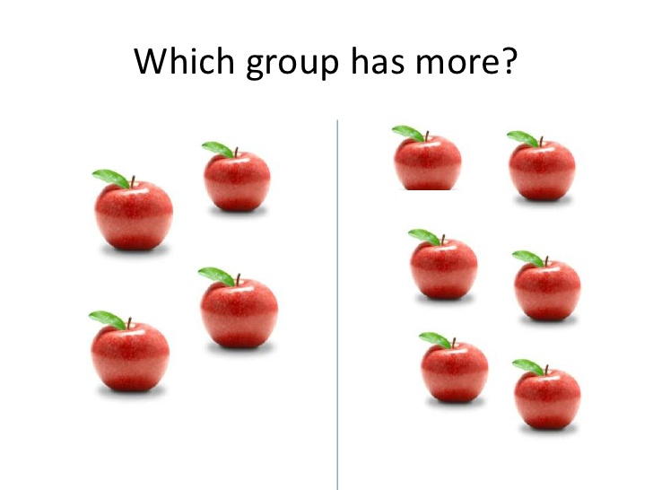
More and Less
Encourage children to determine if sets of things have “more or less.”
This is a perceptual skill at the beginning of the math continuum.
This helps children to build and understand relationships between numbers.
Eventually, children will use one-to-one correspondence to determine which has more and which has less.
How do you support children’s thinking process surrounding more and less?

Slide 12
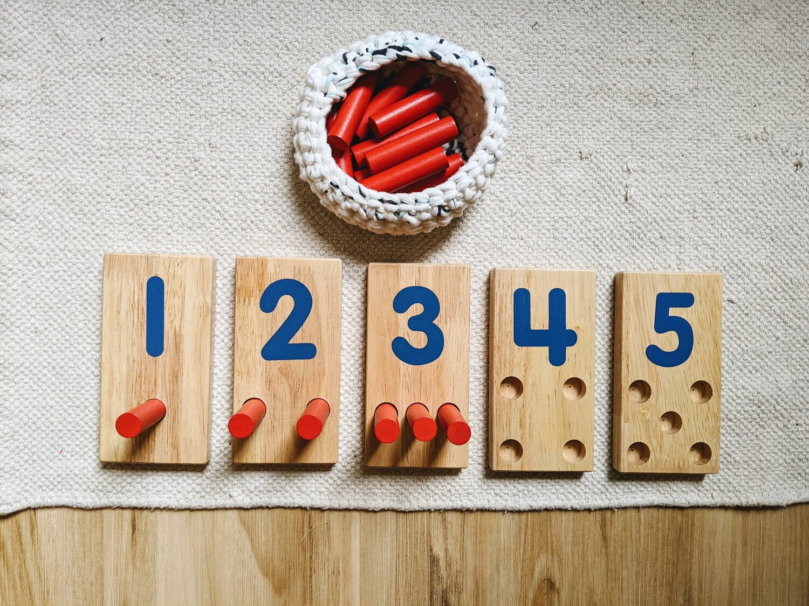
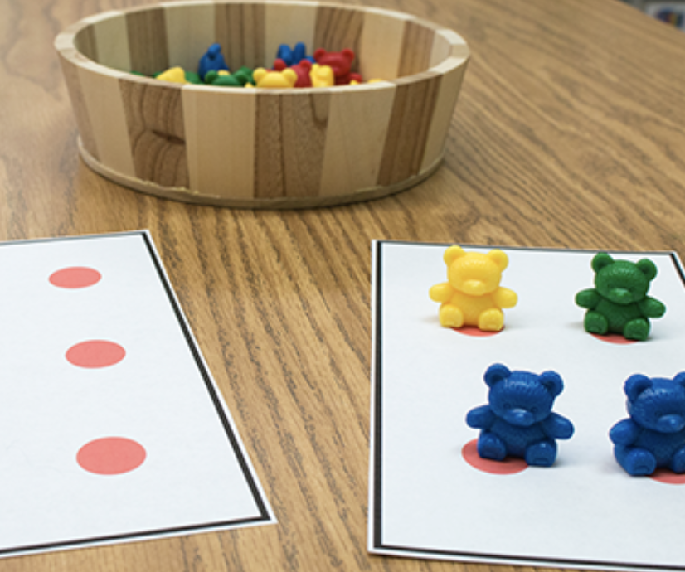
One-to-One Correspondence
Understanding that numbers correspond to specific quantities.
Check out this article for more great information on Why One-to-One Correspondence Matters

Slide 13
Watch this video for additional one-to-one correspondence insight!

Slide 14
Cardinality
Watch me!
Check out this great resource with additional information and ideas surrounding cardinality!
Skill: Counting and Cardinality
Cardinality is the knowledge of how many things are in a set and the number name for that quantity.
Development of cardinality goes hand-in-hand with one-to-one correspondence competency.

Slide 16
Putting it in Practice
Support children with math concepts by exposing them to a variety of materials and activities throughout the day!!
Take attendance: How many boys are here? How many girls are here? Do we have more boys or more girls? How many in all? Do you have an attendance helper?
Counting children as they line up to go outside. How many children do we have in line?
Utilize mealtimes to talk about more, less, and equal to. Who has more peas on their plate? Use number cards with dots to indicate the number of items each child may start with (4 chicken nuggets).
Use intentional teaching strategies throughout choice time, including outside time, to reinforce math concepts. These are great opportunities to use math language as well as reinforce math concepts and skills.

Slide 17
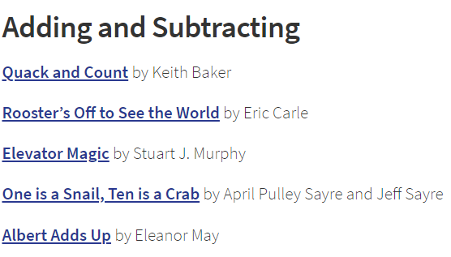
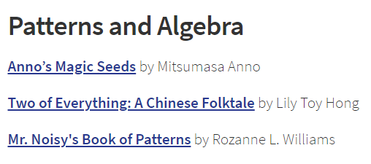
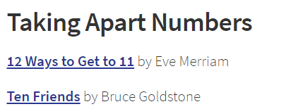
Books to Support Math

Slide 18
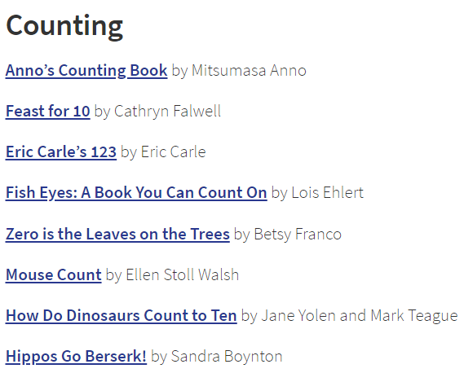
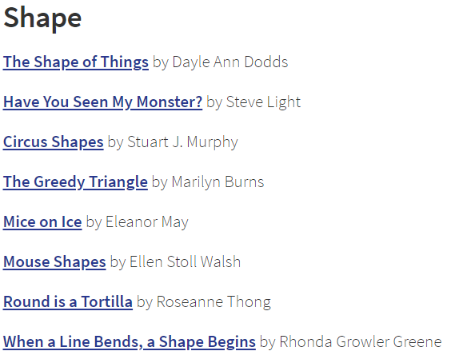
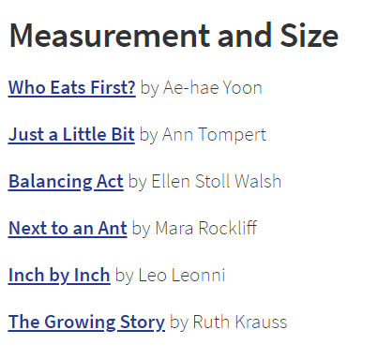
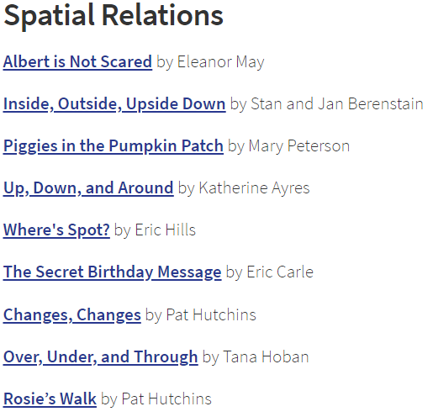
More Books!

Slide 19
Resources
Click here for a free downloadable book

Slide 20
FINAL TRAINING STEPS
Complete the Professional Development Survey on the following slide.
Upon completion of the survey, participants will be entered into a roster on MiRegistry.
This training will appear on participants’ learning record.
Staff can access a training certificate from their profile page on MiRegistry, if desired.
This will serve as an attendance record/sign-in for ChildPlus purposes as well!
Need a link to the PD survey instead? CLICK HERE

Slide 22
References
Fletcher, Graham. “Owning Cardinality.” Vimeo, uploaded by Graham Fletcher, 14 Feb. 2017, https://vimeo.com/204059235.
Fletcher, Graham. “The Progression of Early Learning and Counting.” Vimeo, uploaded by Graham Fletcher, 26 Mar. 2017, https://vimeo.com/210115211.
“Mini Math Lesson – Subitizing.” YouTube, uploaded by The Excellent Educator, 4 Feb. 2018, https://www.youtube.com/watch?v=WRg__tGGbR0&t=332s.
“Skill: Counting and Cardinality.” Virginia Kindergarten Readiness Program, 2018, https://vkrp.virginia.edu/content/pdfs/VKRP_COUNTINGCARD_5_2_SVL.pdf.
“Supporting Mathematical Development in Young Children: One to One Correspondence.” YouTube, uploaded by Connecticut Office of Early Childhood, 27 May 2016, https://www.youtube.com/watch?v=FLehpAp0OyA.
“The Big Bang Theory – Mathematical Research.” YouTube, uploaded by elzr, 14 Oct. 2013, https://www.youtube.com/watch?v=tPR5O5e_DIc.
Uscianowski, Colleen and Gingsberg, Herbert P. “40 Children’s Books that Foster a Love of Math.” Development and Research in Early Math Education, 30 May 2019, https://dreme.stanford.edu/news/children-s-books-foster-love-math.

Slide 23
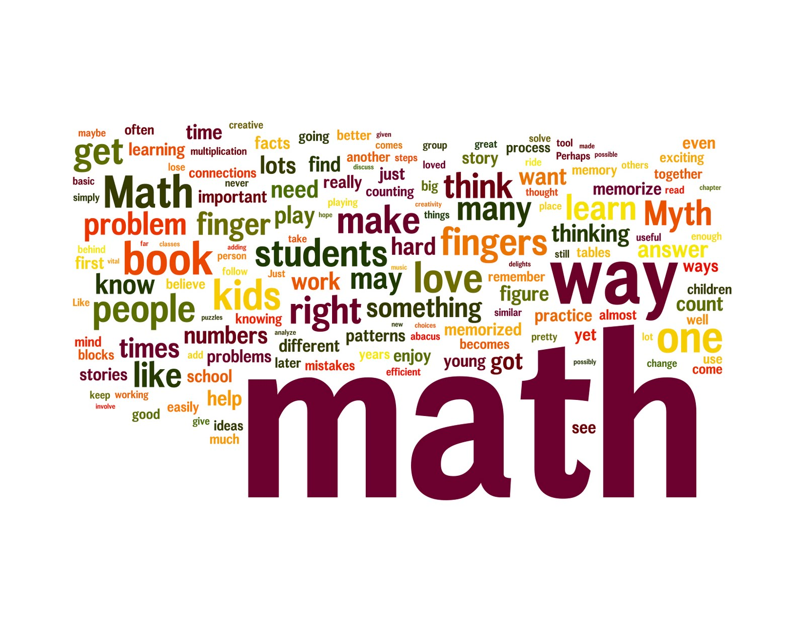
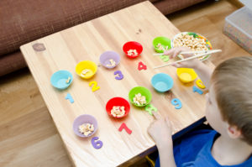
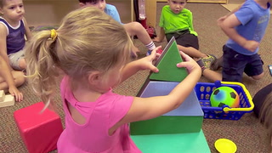
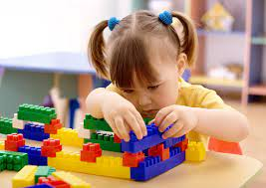
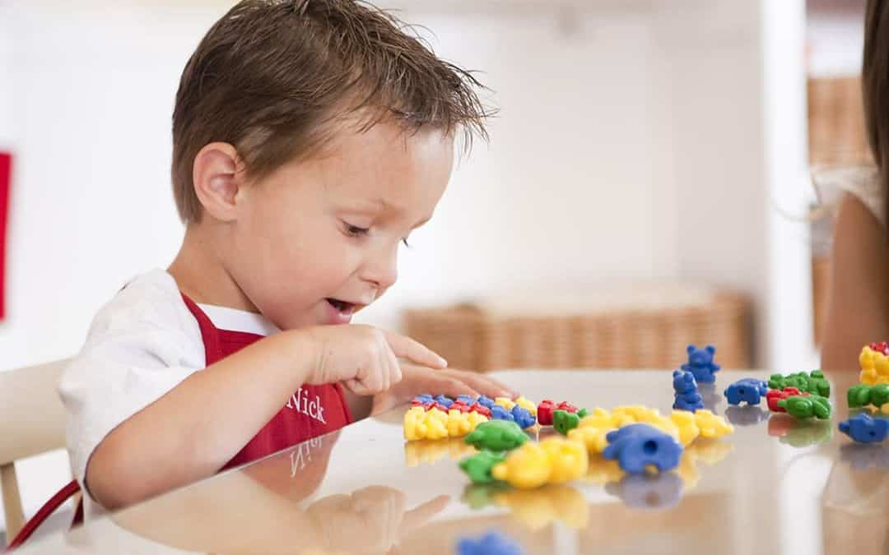
THE END!!

