Slide 1
Praise vs. Encouragement: Promoting a Growth Mindset
Be sure to watch this presentation as a Slide Show!

Slide 2
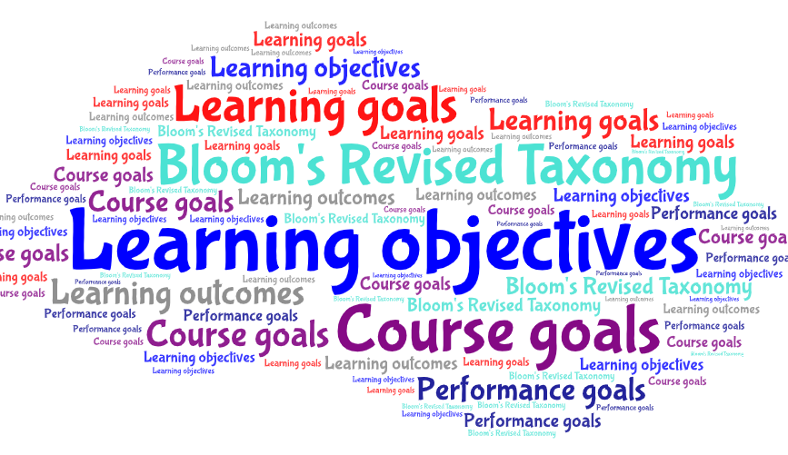
Welcome to this presentation!
LEARNING OBJECTIVES
Explore the development of self-concept in young children.
Examine praise and encouragement: what’s the difference?
Reflect on how the use of encouragement promotes a “growth mindset” in young children.
Provide resources to support an encouraging learning environment for young children.

Slide 3
At the end of this presentation, you will find a professional development survey. PLEASE take time to complete this. Your feedback is ESSENTIAL to expand needed resources on a particular topic and to create new professional development opportunities. This is also a time for you to reflect on your prior knowledge and practice. It’s an important piece of the professional development process!
Reflection and feedback are important! Please be sure to complete any included forms as you navigate through this PowerPoint presentation. Thank you!

Slide 4
You are AWESOME!!
Please watch this short video on AWESOME-NESS!

Slide 5
Promoting AWESOME Children
While our goal is for all children to feel that they are “awesome,” how and what we say to children impacts their self-concept development.
First, let’s explore how children develop a concept of self, and the important role educators play in that healthy development.

Slide 6
TEST YOUR KNOWLEDGE
A child’s self-concept……
develops during infancy and stays static at the age of 5.
is inherited.
is present at birth.
develops as a result of brain maturation and language.

Slide 7
INCORRECT
This is not the best answer. It is true that self-concept develops during infancy, but it also continues to develop into adulthood, and it is not static.
CLICK HERE to try again.

Slide 8
INCORRECT
Self-concept is not an inherited trait, but rather a cognitive and socially developed awareness of oneself.
CLICK HERE to try again.

Slide 9
INCORRECT
The self-concept is not present at birth because the newborn does not yet have the cognitive skills to be consciously aware of oneself.
CLICK HERE to try again.

Slide 10
You picked the correct answer!
Development of self-awareness and a self-concept are dependent on maturation of the brain’s consciousness and ability to use language to express oneself.
CLICK HERE to learn more!

Slide 11
What is Self-Concept?
Please watch this quick video that offers a brief overview of self-concept.

Slide 12
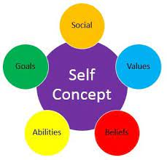
Self-Concept: Digging Deeper
Self-concept includes the attributes, abilities, attitudes, and values that a person believes defines them.
Formation of a positive self-concept begins in Erikson’s toddlerhood stage when children establish autonomy and become confident in their abilities.
Between 18-30 months, children view themselves in a concrete manner: “child or adult,” “boy or girl,” “short or tall.”
As long-term memory develops, children gain a “remembered self.” This incorporates memories that become part of a person’s life story.

Slide 13
Positive Self-Concept
Development of a positive self-concept is important to healthy development.
Children with a positive self-concept tend to be more confident, do better in school, act more independently, and are more willing to try new activities.
Having a healthy self-concept better enables children to deal with frustrations and challenges.
Children who better cope with these frustrations and challenges are more likely to think of themselves as successful and valuable.

Slide 14
Looking-Glass Self
The Looking-Glass Self is a theory that is attributed to self-concept development.
Please watch this brief video for an overview of the Looking-Glass Self theory.

Slide 15
Looking-Glass Self: Key Points
Social interaction plays a major role in the development of self-concept.
Social interaction acts as a “mirror” in which people use the feedback they receive from others to measure their own worth, values, and behavior.
Not all feedback carries the same weight. Feedback from those who are a trusted source may be taken more seriously.
Based on this premise, self-concept is not built in solitude, but rather within social settings.

Slide 16
Social Interactions
We have talked about how important social interactions are in helping children develop a healthy self-concept.
Now let’s take some time to examine more closely interactions that involve feedback; in particular praise versus encouragement.

Slide 17
Take a few minutes to watch this short video on Praise vs. Encouragement.
(It’s geared towards a parental audience but has really good information!)

Slide 18
What is Praise?
Praise is typically a blank statement of opinion. According to the dictionary the definition is, “The expression of approval or admiration for someone or something.” The word that should jump off the screen here is approval.

Slide 19
Praise is Praise is Praise….
Not all praise is created equal. Let’s examine the different types of praise.
Generic Praise
It includes “good job,” “way to go,” “awesome,” “great work,” etc.
The problem with this type of praise is that it’s not attached to what the child did that was good or beneficial so it’s harder for him or her to do the same thing with the same kind of success. It focuses on the outcome instead of the process.
Person Praise
When the praise is directed at what a child’s innate qualities are, this is called character or person praise. Examples include calling a child smart, responsible, helpful, or generous.

Slide 20
Why Encouragement?
Encouragement is a more preferable way to acknowledge children’s efforts.
“It is an observation, an acknowledgment, a statement which focuses on effort, improvement of choice, and it helps to promote self-esteem and a sense of well-being, confidence, insight, and resilience.”
Acknowledges actions. This helps children understand what they did well so they can do it again.
Acknowledges strengths such as ability, talent, skills, positive personality traits to recognize the inner assets the child has brought to the situation. You’re showing the child how his strengths work, not just what they are.
“You were very responsible (PERSON) for packing your clothes by doing it all yourself without being asked (PROCESS). You used your ability to organize (STRENGTH) to get your clothes packed in time for our trip.”

Slide 21
Words Matter
Do you see the difference between praise and encouragement? Do you see how praise could (oftentimes unintentionally) be detrimental to a child’s confidence? It could cause children to be dependent on our approval.
Encouragement focuses on effort, improvement, technique or strategy. It focuses on the behaviors we want to see again.
Encouragement is needed to cultivate a growth mindset. It makes children feel good about their choices, help them see what it takes to be successful so they can do it again, and it can develop optimism and resilience for future outcomes.

Slide 22
TEST YOUR KNOWLEDGE
A child is in the art area and says, “Ms. M, look at my picture.” What might be the most appropriate way to respond?
Oooh, that’s beautiful!
You’re so awesome. Your mom is going to love it.
It looks like you’ve been working hard. I see lots of blue and orange and red. Tell me all about your picture!

Slide 23
THAT’S NOT QUITE RIGHT!
“Ooh, that is beautiful” is a form of praise that focuses on the outcome rather than the process of creating the art. It is a judgment statement.
CLICK HERE to try again!

Slide 24
THAT’S NOT QUITE RIGHT!
“You’re so awesome. Your mom is going to love it,” is person or character praise. It focuses on the child’s innate qualities.
CLICK HERE to try again!

Slide 25
You picked the correct answer!
This statement acknowledges the child’s effort and asks him/her to reflect on how they feel about their work!
CLICK HERE to keep going!

Slide 26
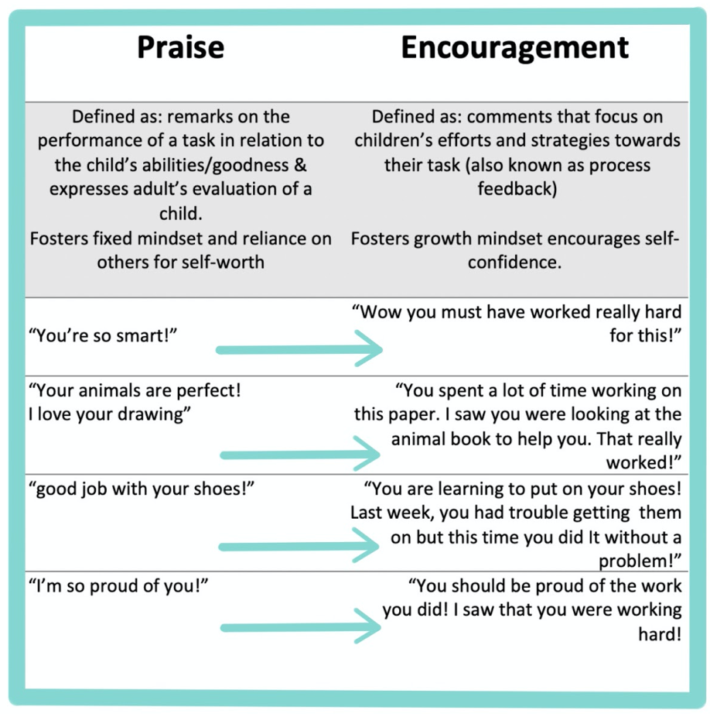

Slide 27
REFLECTION
Please take a few minutes to reflect on self-concept and the use of praise versus encouragement.
On the next slide, complete the survey form with your thoughts and answers.
Be sure to hit submit when you’re finished!

Slide 29
A “Growth Mindset” Goal
We understand that our role as early childhood educators is to help children develop a healthy self-concept. We also understand and value that development is influenced by the social interactions that we have, and specifically the use of encouragement rather than praise.
We ultimately want children to have a “growth mindset.” But what is a growth mindset and why is it important?
Let’s keep going to find out about this very important concept!

Slide 30
Please watch this brief overview of “Growth Mindset.”

Slide 31
Growth Mindset & Early Childhood
It’s easy to see how using encouragement rather than generic or person praise can promote a healthy growth mindset in young children.
What other strategies can we use to promote this important mindset in young children?
Let’s dig a little deeper to find out!

Slide 32
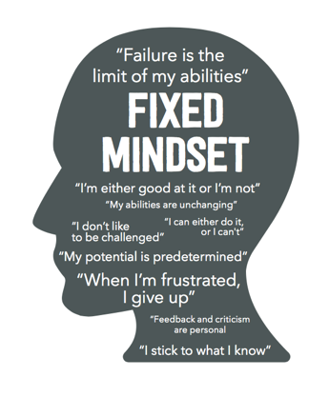
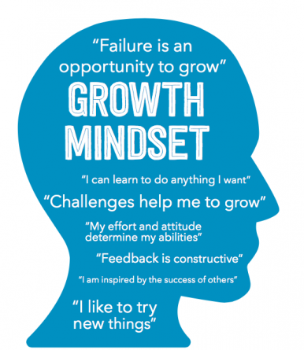
Fixed or Growth Mindset
Learners face challenges and tasks with one of two mindsets.
Fixed Mindset:
“I did well because I’m smart” or “I failed because I am dumb.”
It’s a mindset based on an already pre-determined outcome.
People with this mindset may lack motivation to keep going because they feel like the outcome will be the same no matter what.
Growth Mindset:
“Failure” at a task is seen as an opportunity for future successes.
Challenges are considered as a motivation to what to keep going and develop new skills.
Confidence is built through effort.

Slide 33
Please watch this short video on helping children reach their full potential. It is narrated by Carol Dweck, who conducted years of research regarding the importance of developing a positive growth mindset.

Slide 34
Encouraging Growth Mindset
There is much more to growth mindset than the use of encouragement versus praise.
Other areas to focus on with young children include the following:
Problem-solving
Confidence building
Accepting mistakes and failures as part of the process
But how do we help children with all these pieces?

Slide 35
Growth Mindset Strategies
Problem Solve
Allow children to problem-solve.
Don’t be so quick to fix all children’s problems.
Ask, “How can you fix this?”
Stay close to offer additional support, as needed.
Time & Space
Allow children the time and space to use materials in their own way.
This supports confidence building, independence, and creative problem-solving.
Risk
Encourage risk taking.
Using real tools, climbing higher on equipment, or touching those bugs found outside.
Of course, safety comes first, so be sure to have boundaries.
Peer Support
Encourage peer help before adult help.
This also helps to build a stronger classroom community.
Emotions
Make space for frustration.
Be open and talk about emotions and how to deal with them.
ENCOURAGE
Encourage, encourage, encourage: Be authentic and specific!

Slide 36
Words You Can Use

Slide 37
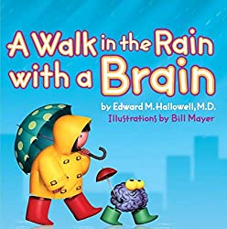
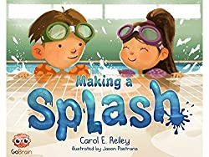
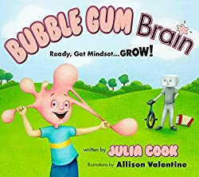
Growth Mindset Resources
Here are some handy books to support growth mindset with children. Click on each image for more information.

Slide 38
FINAL TRAINING STEPS
Complete the Professional Development Survey on the following slide.
Upon completion of the survey, participants will be entered into a roster on MiRegistry.
This training will appear on participants’ learning record.
Staff can access a training certificate from their profile page on MiRegistry, if desired.
This will serve as an attendance record/sign-in for ChildPlus purposes as well!
Need a link to the PD survey instead? CLICK HERE

Slide 40
REFERENCES
“Growth Mindset Introduction: What It Is, How It Works, and Why It Matters.” YouTube, uploaded by Trevor Ragan, 7 Nov. 2016, https://www.youtube.com/watch?v=75GFzikmRY0.
“You Are Awesome.” YouTube, uploaded by Peacock Kids, 27 March 2015, https://www.youtube.com/watch?v=SSW0WbxkH0U.
“What Is The Self-Concept?” YouTube, uploaded by Kit Welchlin, 15 Feb. 2015, https://www.youtube.com/watch?v=mvbYE99F0WA.
“Looking Glass Self.” YouTube, uploaded by Mr. Sinn, 24 Sept. 2018, https://www.youtube.com/watch?v=ukSScFhVrBM.
“Praise vs. Encouragement: Explore Their Differences.” YouTube, uploaded by Stuff4Tots, 26 July 2021, https://www.youtube.com/watch?v=LMDn8U0Mnbc.
“RSA Animate: How to Help Every Child Fullfil Their Potential.” YouTube, uploaded by RSA, 15 Dec. 2015, https://www.youtube.com/watch?v=Yl9TVbAal5s&t=13s.

Slide 41
THE END!

