Slide 1
Phonological Awareness: The Basics
Be sure to watch this presentation as a Slide Show!

Slide 2
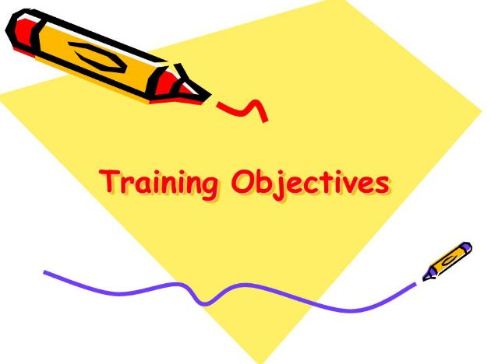
OUR GOALS
Understand what phonological awareness is and why it’s important.
Recognize how phonological awareness is connected to the Head Start Early Learning Outcomes Framework (HSELOF).
Examine the “building blocks” of phonological awareness.
Demonstrate knowledge of the phonological awareness continuum in children 0-5.
Gain resources, activities, and ideas for supporting phonological awareness with the children you serve.

Slide 3
At the end of this presentation, you will find a professional development survey. PLEASE take time to complete this. Your feedback is ESSENTIAL to expand needed resources on a particular topic and to create new professional development opportunities. This is also a time for you to reflect on your prior knowledge and practice. It’s an important piece of the professional development process!
Reflection and feedback are important! Please be sure to complete any included forms as you navigate through this PowerPoint presentation. Thank you!

Slide 4
Rhyming: Bert & Ernie Style
Take a few minutes to watch this fun video courtesy of Bert and Ernie!

Slide 5
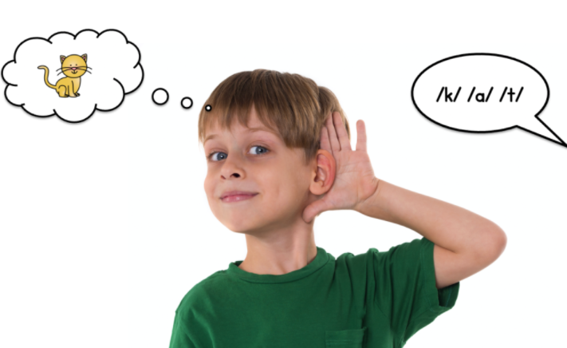
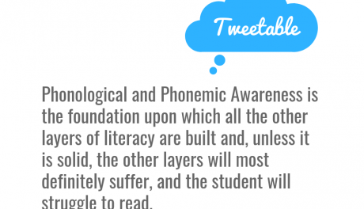
Phonological Awareness
What is it?
Phonological awareness focuses on the sounds children hear, not the letters or words.
It is the ability to recognize and manipulate different sounds in words and sentences.
Why is it important?
It is the foundation for learning to read!!

Slide 6
What is phonological awareness?
Please take a few minutes to watch this short video that provides a phonological awareness overview.

Slide 7
Head Start Requirements
The Head Start Early Learning Outcomes Framework (HSELOF) lays out the skills, behaviors, and knowledge that programs must foster in ALL children.
Phonological awareness is a piece of this!

Slide 8
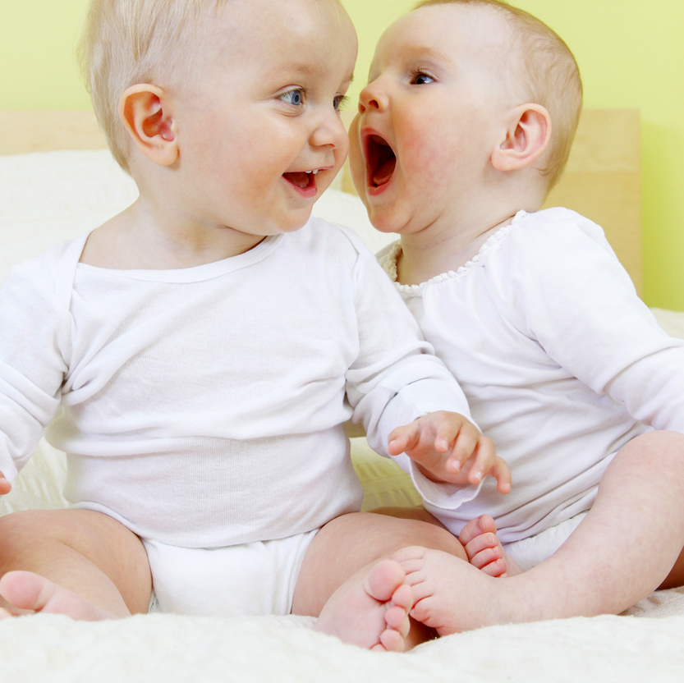
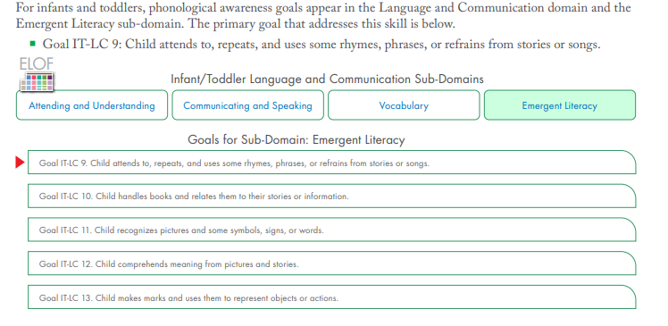
HSELOF & Infant/Toddler Development

Slide 9
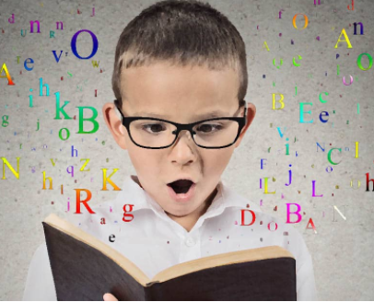
HSELOF & Preschool Development
Please CLICK HERE to read an article on phonological awareness from the National Center on Early Childhood Development, Teaching and Learning.

Slide 10
State of Michigan Standards: Infant/Toddler
The State of Michigan developed the Early childhood Standards of Quality for Infant and Toddler Programs (ECSQ-IT) to support programs with providing high quality settings.
The ECSQ-IT aligns with licensing regulations and Head Start Performance Standards.
Please CLICK HERE to access a copy of the ECSQ-IT.

Slide 11
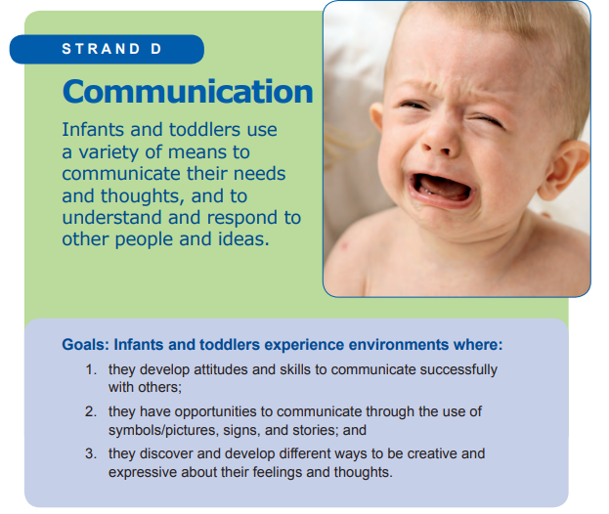
ECSQ-IT & Phonological Awareness
Early Knowledge, Skills, and Attitudes Infants and Toddlers Begin to Develop
The ability to express their feelings and emotions in a range of appropriate ways.
b. Confidence that their first languages [e.g., whether spoken English, a spoken language other than English, or American Sign Language (ASL)] are valued, supported, and understood.
Responsive and reciprocal communication skills (e.g., turn-taking).
A playful interest in repetitive sounds and words, and aspects of language (e.g., rhythm, rhyme, alliteration).
Increasing skill with and understanding of non-verbal messages, including the ability to attend to and make non-verbal requests.
The inclination and ability to communicate, pay attention, and respond appropriately to others.
Increasing knowledge and skill in syntax, meaning, and vocabulary in at least one language.
Language skills in real, play, and problem-solving contexts as well as in more structured language contexts (e.g., through books, finger plays, singing, storytelling/re-enacting).
Communication skills for increasingly complex purposes (e.g., expressing and asking others about intentions, expressing feelings and attitudes, negotiating, predicting, planning, reasoning, guessing, storytelling).

Slide 12
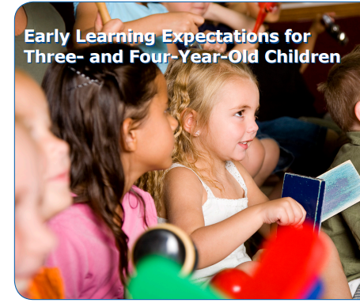
State of Michigan Standards: Preschool
Like the ECSQ-IT, the State of Michigan developed the Early Childhood Standards of Quality for Prekindergarten (ECSQ-PK) to support programs with providing high quality settings.
The ECSQ-PK aligns with licensing regulations and Head Start Performance Standards.
Please CLICK HERE to access a copy of the ECSQ-PK.

Slide 13
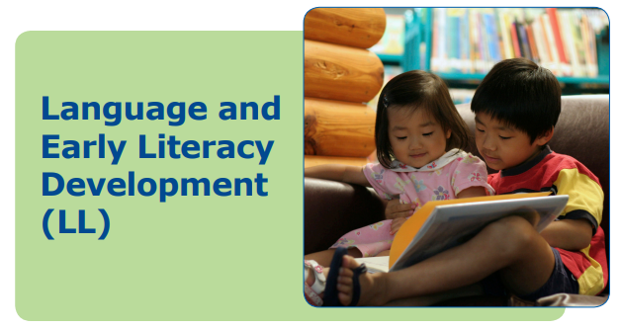
ECSQ-PK & Phonological Awareness
Emerging Indicators:
Use spoken language for a variety of purposes (e.g., to express feelings, to ask questions, to talk about their experiences, to ask for what they need, to respond to others).
Show increasing comfort and confidence when speaking.
Experiment and play with sounds (e.g., rhyming, alliteration, playing with sounds, and other aspects of phonological awareness).
Continue to develop vocabulary by using words learned from stories and other sources in conversations.
Speak in increasingly more complex combinations of words and in sentences.
Understand the roles of the participants in conversation (e.g., taking turns in conversation and relating their own comments to what is being talked about; asking relevant questions).
Take part in different kinds of roles as a speaker (e.g., part of a group discussion, role playing, fantasy play, storytelling and retelling).
Use nonverbal expressions and gestures to match and reinforce spoken expression.
Show progress in speaking both their home language and English (if non-English-speaking children).
If appropriate, show progress in learning alternative communication strategies such as sign language.

Slide 14
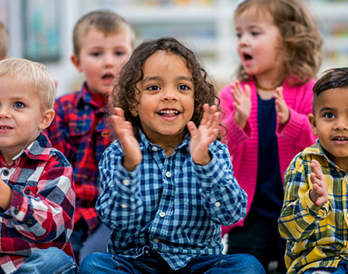
Phonological Awareness Expectations
Phonological awareness follows a continuum of learning just like other areas of development. For early childhood, the focus is typically on the following:
Rhyming
Alliteration
Segmenting & Syllables
Let’s take a more in-depth look at each of these areas!

Slide 15
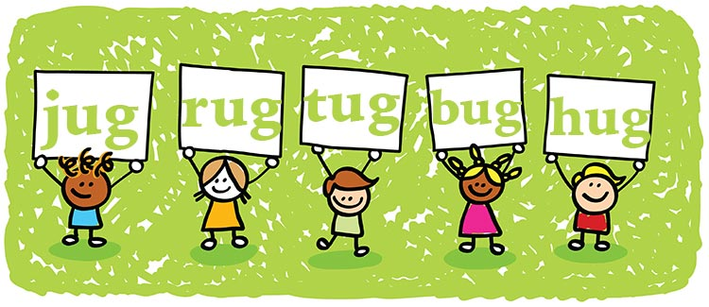
RHYMING
Rhyming helps a child’s brain in the following ways:
Learn how to break words down into smaller words.
Learn how to discern the differences among individual sounds (phonemes).
Train the ear to hear the differences and similarities in how different words sound.
Experience the rhythm of language. Animated voices leads to reading with inflection and expression.
Make predictions. Children learn to anticipate a rhyming word when they become familiar with a particular nursery rhyme or book.
Prepare for writing. Children learn to understand that words that share common sounds often share common letters.

Slide 16
Share Rhymes: Backbone of Reading Skills
Please watch this short video that highlights the importance of rhyming, and how reading books and reciting nursery rhymes benefits young children.

Slide 17
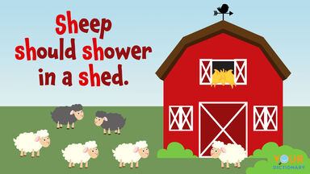
ALLITERATION
Alliteration is the repetition of words with the same beginning sound.
When young children hear and notice words that begin with the same sound, they begin to identify and isolate individual phonemes.
Alliteration supports children’s listening and recognition skills. Children learn to make important connections!
Like rhyming, alliteration provides rhythm to language.
Alliteration also provides rhyming opportunities…and we already know rhyming is an important component of phonological awareness!
Please read the following article about the importance of nursery rhymes for young children! CLICK HERE

Slide 18
Resources with Dr. Jean
Please watch this informative video with Dr. Jean Feldman regarding the importance of fingerplays and nursery rhymes in literacy development.
*** Links to her nursery rhyme and finger play videos are on the Resources page near the end of this PowerPoint.

Slide 19
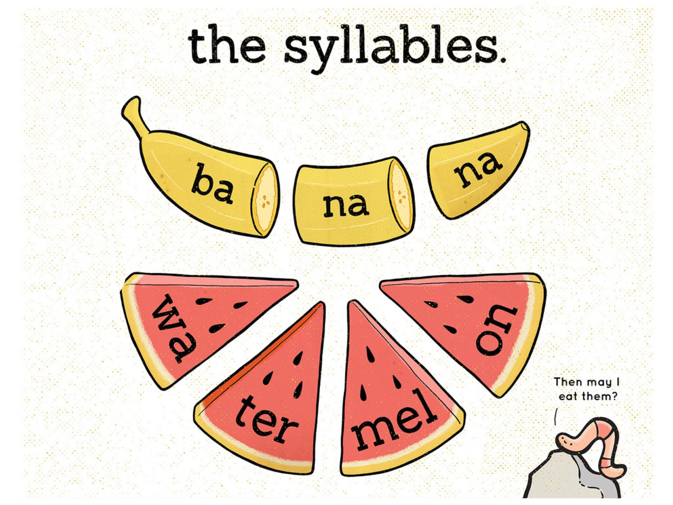
Segmenting & Syllables
Recognizing that sentences can be broken down into words, and that words can be broken down into sounds, is segmenting.
Children who can segment and break words into syllables use this knowledge later when they learn to read!
The use of syllables is breaking words down into parts or “chunks.” This will help children later as they learn to “decode” while reading.
Basic understanding of syllables will also help children learn to spell words correctly.

Slide 20
Drumming Out Syllables
Please take a few minutes to watch this brief video. See how easily the teacher incorporates the concept of syllables during this activity.

Slide 21
Phonological Awareness: Another Look
It’s important to provide children with rich experiences that encompass rhyming, alliteration, and segmenting.
Take a few minutes to watch the following video regarding the benefits of these important skills.

Slide 22
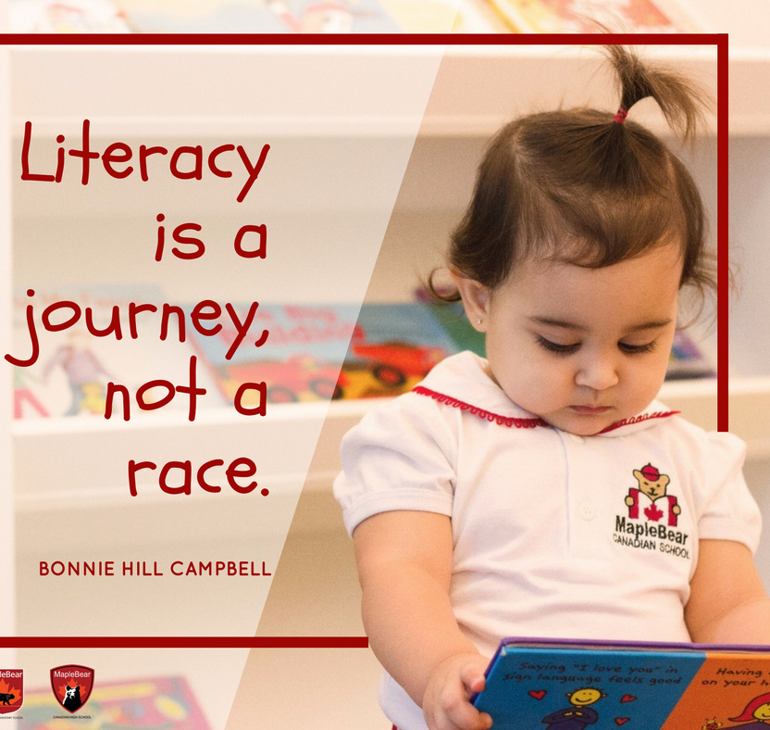
Phonological Awareness & the Learning Continuum
Children’s phonological awareness develops along a continuum of learning, just like other areas of development.
On the next few slides, take a few minutes to review “Objective 15: Demonstrates Phonological Awareness…..(a-c)” from Teaching Strategies GOLD’s “Objectives for Development and Learning.”

Slide 23
TS GOLD’s COLOR BANDS
Here’s a quick overview of TS GOLD’s color bands and their associated age ranges. Use these as a guide while reviewing the next few slides.

Slide 24
RHYME

Slide 25
ALLITERATION

Slide 26
SEGMENTING/SYLLABLES

Slide 27
Next Steps
We’ve spent time examining some essential pieces of phonological awareness development. How do we intentionally implement activities and experiences to support children in this area?
On the next few slides, let’s explore some strategies and resources surrounding phonological awareness.

Slide 28
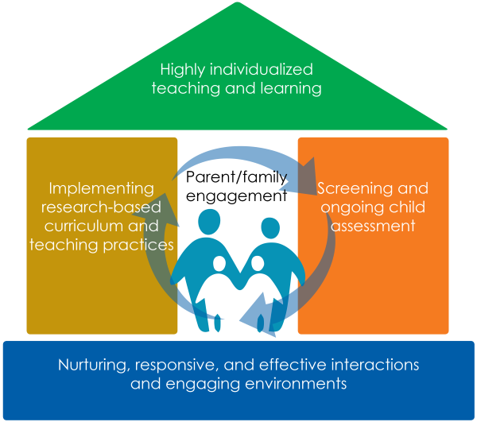
Strategies that Work
When focusing on phonological awareness development, intentional teaching is key!
This includes setting up a literacy-rich environment in which children can engage with meaningful materials.
And of course, positive adult-child interactions are crucial.
Let’s take a look at some resources from ECLKC on the next few slides!

Slide 29
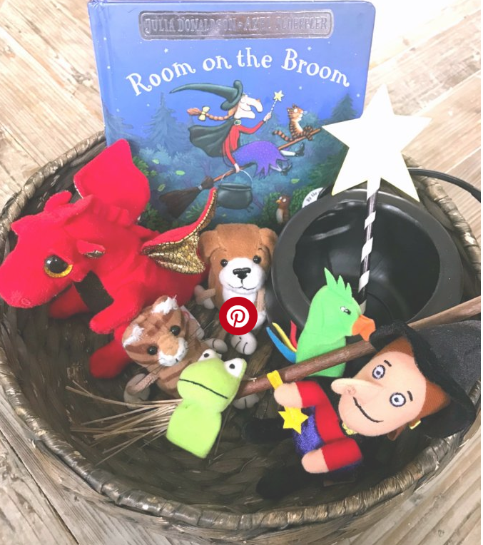
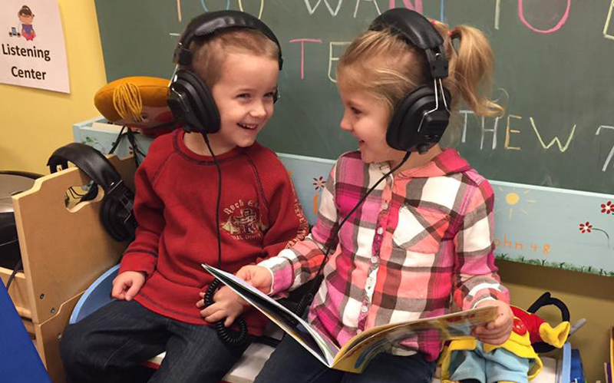
ENVIRONMENT https://eclkc.ohs.acf.hhs.gov/school-readiness/effective-practice-guides/phonological-awareness-know
Set up a listening center with recordings of songs and books that include language play. Ms. Kelley greets a parent who arrived early. “Good morning, Mr. Lopez. Thank you for coming. We set up a recording studio for you in the office. Here are the books we’d like you to read. Have as much fun with them as you like. Uno, Dos, Tres: One, Two, Three is a current favorite. When you are done, we’ll add them to our listening center.”
Provide puppets and props that go with rhyming and word play books to encourage children to revisit the books on their own. After repeated readings of the rhyming book Trashy Town, Ms. Fey placed it in the block center with some dump trucks and plain hats with brims. Soon, she heard the children repeating the refrain as they played, “Dump it in, smash it down, drive around the Trashy Town!”

Slide 30
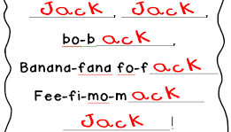
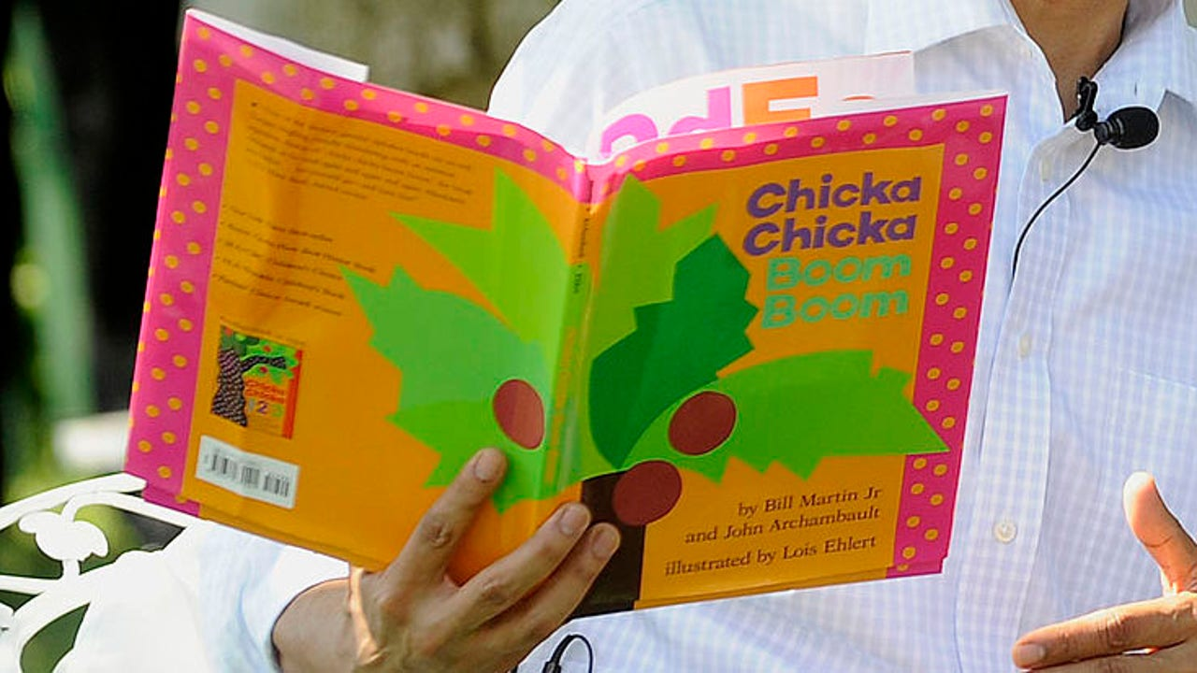
INTERACTIONS
Play games and sing songs throughout the day that build phonological awareness. Several of the children at today’s group socialization session have finished cleaning up and are putting on their coats for an outdoor activity. Ms. Green, Jeremy’s mother, leads them in a game of I Spy. She says, “I spy with my little eye something that begins with /b/. Hmmm, what could it be?” “I know, I know,” says Inez. “It’s blocks!” “Bloques (blocks in Spanish),” adds Miguel. “Bé (baby in Vietnamese),” laughs Binh. “No, mommy, it’s ball; right?” asks Jeremy. Home visitor Ms. Anderson says to Jeremy's mom, “Ms. Green, the children love that game. It keeps them busy while waiting and it teaches them about letter sounds.”
Read aloud books and poetry that play with sounds and words. Every week, Ms. Perez chooses a book to read with the children that has lots of rhyming and word play. She reads it every day, along with other books, while focusing on the sounds. By Wednesday, the children start joining in. When she reads, “A told B, and B told C,” the children add, “I'll meet you at the top of the coconut tree." And by the end of the week, “Chicka, Chicka” might turn into “Tricka, Tricka,” or “Quicka, Quicka.”

Slide 31
INDIVIDUALIZATION
Use children’s names often and highlight the sounds found in them. It’s group meeting time and Ms. Jansen and the preschoolers are singing a morning song, “Clap a friend’s name with me ...” The first name they clap is Dionte. The children clap three times singing, “Di-on-te.” Next comes Amanda, also three claps, and then four claps for Isabella, “I-sa- bel-la.” Later in the day, Ms. Jansen often hears the children clapping out words on their own, like “Veg-gie-roll-ups for snack today.”
Incorporate word play naturally when holding individual conversations with children. “Thomas,” says Ms. Mott, “that is a terrific, tall tower you built today.” Thomas laughs and says, “Yep, Thomas’s terrific, tall tower. T, T, T.” Later, while helping Rosie find a lost hat, she says, “Let’s think of a word that rhymes with hat. Will that help us find it?” “I don’t know,” says Rosie. “Let’s try,” says Ms. Mott. “Hat, bat, sat, mat ... .”

Slide 32
Sing a Silly Song
Singing is an easy way to engage children in phonological awareness activities.
Please watch the following video. See how the children are actively engaged in learning phonological awareness concepts all while having fun?

Slide 33
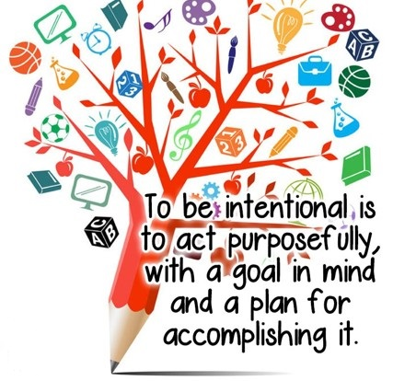
Putting it in Practice
Watch and listen for children’s spontaneous play with sounds of language. Respond by encouraging and extending it. For example:
When a child taps two blocks together while vocalizing, “bam, bam, boom, boom,” join in by tapping two blocks while saying, “zam, zam, zoom zoom.” Extend the play by asking, “What other sounds can you tap?”
Similarities between phonemes (individual sounds) in English and children’s home languages can be used as a foundation for building phonological awareness (e.g., if the child’s home language has some of the same phonemes as English, start using them for rhymes or beginning sound learning experiences as they are sounds with which children are already familiar).
Offer opportunities that involve rhymes. For example:
Sing rhyming songs and play rhyming games.
Read books and poetry that have rhyming words.
Invite children to fill in rhyming words (e.g., "One, two, buckle my ___ (shoe)").
Encourage children to make up their own rhymes.
Play word-combining games to make compound words like raincoat and sunshine. Use photos or pictures for visual cues and to make the games hands-on for children.
Clap the syllables in a child’s name to identify them during transitions (e.g., Me-lin-da, Char-lie, Gi-o-van-na) or in a sentence (e.g., “We are going outside (six claps)").
For older preschoolers, play guessing games in which children add sounds together (e.g., /c/ + /up/ = cup) or subtract beginning sounds to make a new word (e.g., rice - /r/ = ice).
https://eclkc.ohs.acf.hhs.gov/school-readiness/effective-practice-guides/phonological-awareness-do

Slide 34
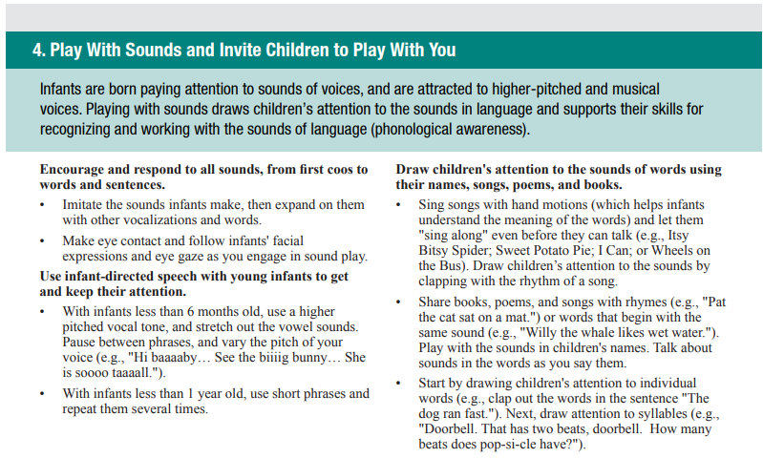
Early Phonological Awareness Development
Remember, developing phonological awareness doesn’t begin in preschool. Infants and toddlers are developing this awareness, too!
Check out these ideas from the Michigan Association of Intermediate School Administrators General Education Leadership Network Early Literacy Task Force (2018).
https://www.gomaisa.org/downloads/literacy_essentials/emergentliteracy_b-3_061919.pdf

Slide 35
One Last Look
Please take a few minutes to watch this informative video regarding phonological awareness.

Slide 36
Exercise, Rhyme & Freeze
You’re almost done! Time to get up and move! Check out this fun video that incorporates rhyming and movement. How could you adapt this for use in your classroom?
After the video, take time to check out additional resources and complete the professional development survey!

Slide 37
ECLKC: Phonological Awareness
Essential Instructional Practices in Language and Emergent Literacy: Birth to Age 3
Essential Instructional Practices in Early Literacy: Prekindergarten
Fingerplays with Dr. Jean
Nursery Rhymes with Dr. Jean

Slide 38
FINAL TRAINING STEPS
Complete the Professional Development Survey on the following slide.
Upon completion of the survey, participants will be entered into a roster on MiRegistry.
This training will appear on participants’ learning record.
Staff can access a training certificate from their profile page on MiRegistry, if desired.
This will also serve as an attendance record/sign-in sheet for ChildPlus purposes.
Need a link to the PD survey instead? CLICK HERE

Slide 40
References
“Developing Phonological Awareness in Preschool Children.” youtube, uploaded by National Center for Families Learning, 30 Jan. 2018, https://www.youtube.com/watch?v=XnuQhsRf3Pc.
“Drumming Out Syllables: Foundations for Phonemic Awareness.” youtube, uploaded by The Balanced Literacy Diet, 25 Nov. 2011, https://www.youtube.com/watch?v=N6i66zjIx9I&t=1s.
“Exercise, Rhyme & Freeze.” youtube, uploaded by Jack Hartmann Kids Music Channel, 15 Dec. 2017, https://www.youtube.com/watch?v=cSPmGPIyykU.
“Pre-K Essential 4, bullet 2: Singing Songs to Promote Phonemic Awareness Sample Video.” youtube, uploaded by Michigan Virtual, 17 Oct. 2018, https://www.youtube.com/watch?v=7vE2H1ezt7M&list=PLEr3aBYwhAcfb2C511bDBR0ZNBY3y1ZOz&index=40&t=1s.
“Nursery Rhymes & Fingerplays Into with Dr. Jean.” youtube, uploaded by ESC Region 13, 14 Sept. 2017, https://www.youtube.com/watch?v=Zmszqroq1pM&list=PLJIQbYYe5Zs1AmWnrs4aR3uCQaoD7EW5A&index=11.
“Reach Workshop Series: Phonological Awareness.” youtube, uploaded by NEFEC, 30 Sept. 2011, https://www.youtube.com/watch?v=LucNw_2G_FU.
“Share Rhymes: Backbone of Reading Skills.” youtube, uploaded by OakParkPublicLibrary, 25 Feb. 2016, https://www.youtube.com/watch?v=sdW7oCH9qbg.
“What is Phonological Awareness?”youtube, uploaded by Riverside School, 18 January 2019, https://www.youtube.com/watch?v=xw35qAhP9jM.

Slide 41
THE END!

